Slide 1
Optimal morphs of Planar Orthogonal Drawings
II
Arthur van Goethem
Bettina Speckmann
Kevin Verbeek

Slide 2
Introduction

Slide 3
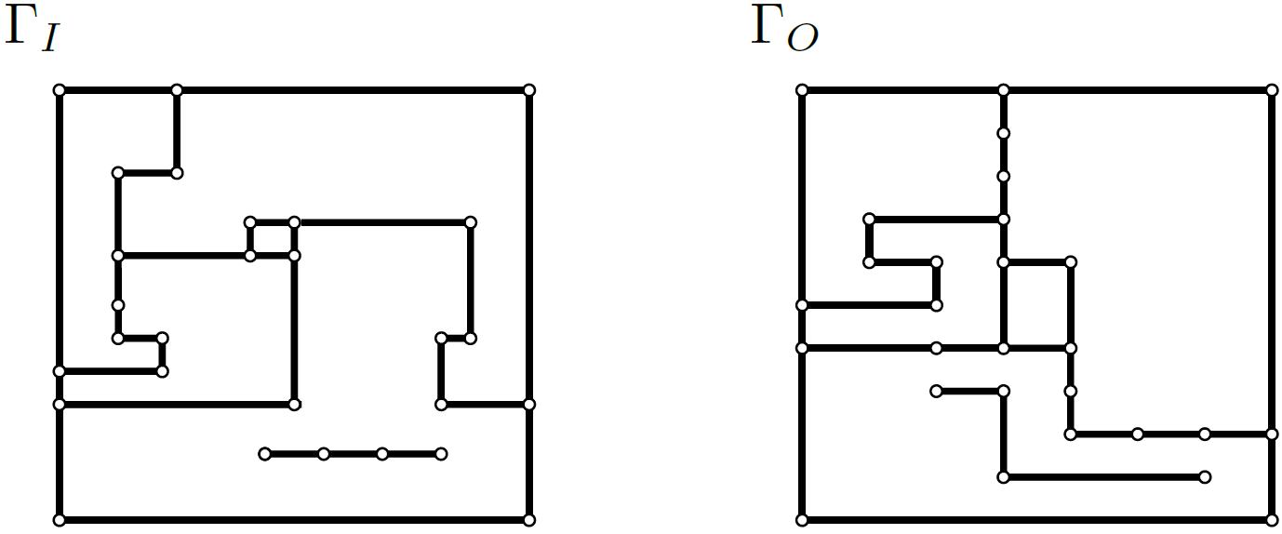
Introduction
Problem
Given two equivalent orthogonal drawings $Γ_{I}$ and $Γ_{O}$ of a planar (dis)connected graph $G$,
turn $Γ_{I}$ into $Γ_{O}$ with the minimum number of linear morphs
while planarity, orthogonality, and linear complexity

Slide 4
Introduction

Slide 5
Previous work
Morphing Orthogonal Graph Drawings
Biedl et al. (2013) Morphing Orthogonal Planar Graph Drawings
van Goethem, Verbeek (2018) Optimal Morphs of Planar Orthogonal Drawings
 | Connected | Disconnected
[Biedl et al. 2013] | $$O(n^{2})$$ | $$O(n^{2})$$
[SoCG 2018] | $$O(n)$$ | $$O(n\sqrt{n})$$
[GD 2019] | $$O(n)$$ | $$O(n)$$

Slide 6
Previous work
Connected graph [SoCG 2018]
Spirality $s = O(n)$
Batched linear morphs [GD 2019]
$s+1$ linear morphs
Morph using wires [SoCG 2018]
$O(s)$ linear morphs
Disconnected graph [SoCG 2018]
Spirality $s = O(n\sqrt{n})$
Disconnected graph [GD 2019]
Spirality $s = O(n)$

Slide 7
WIRES
Morph using wires [SoCG 2018]
$O(s)$ linear morphs
Input
Reduce spirality tb-wires
Reduce complexity
Reduce spirality lr-wires
Output

Slide 8
Wires

Slide 9
Wires
Wires: orthogonal polylines that capture the horizontal and vertical order of the vertices.
Lr-wire (red): left to right wire
Tb-wire (blue): top to bottom wire

Slide 10
Wires
Wires: orthogonal polylines that capture the horizontal and vertical order of the vertices.
Lr-wire (red): left to right wire
Tb-wire (blue): top to bottom wire

Slide 11
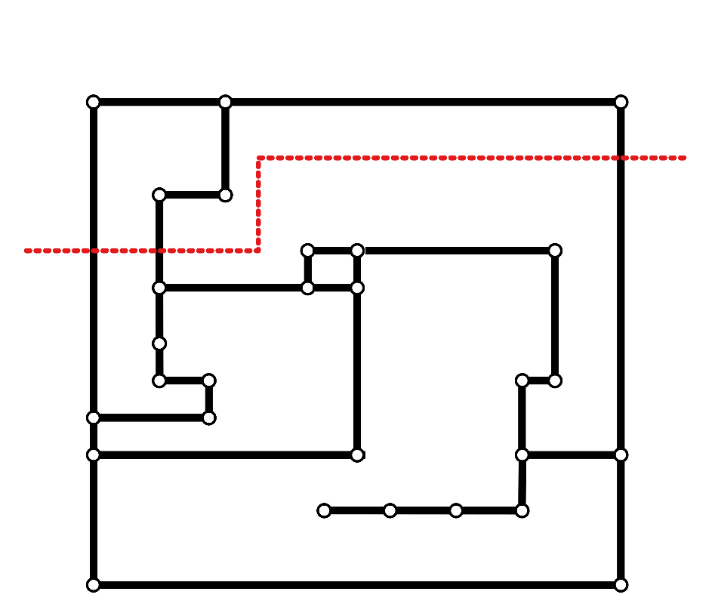
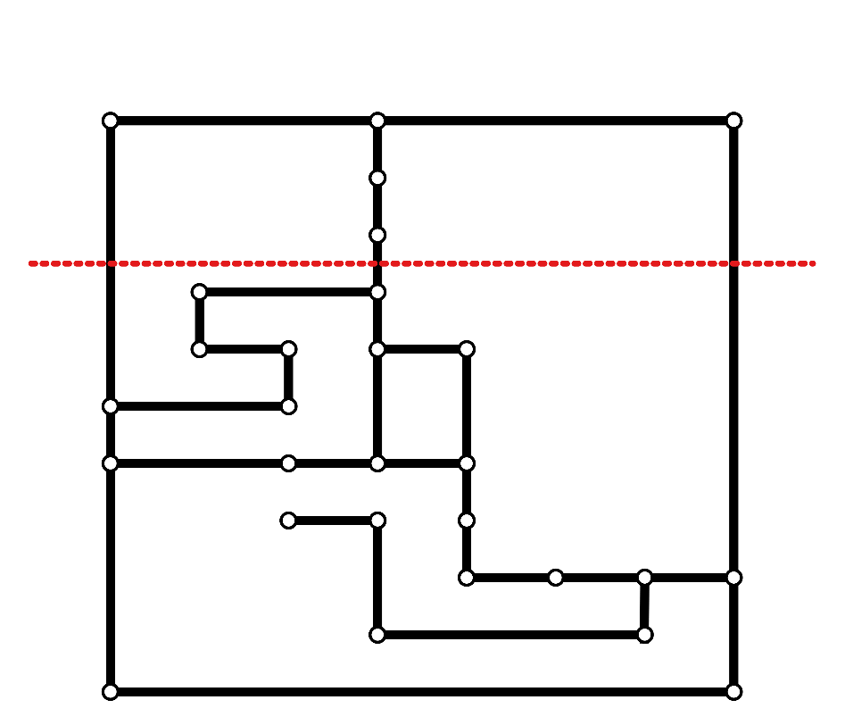
Wires
Notes:
Mention wire (1) partitions vertices, (2) crosses edges in same order.

Slide 12
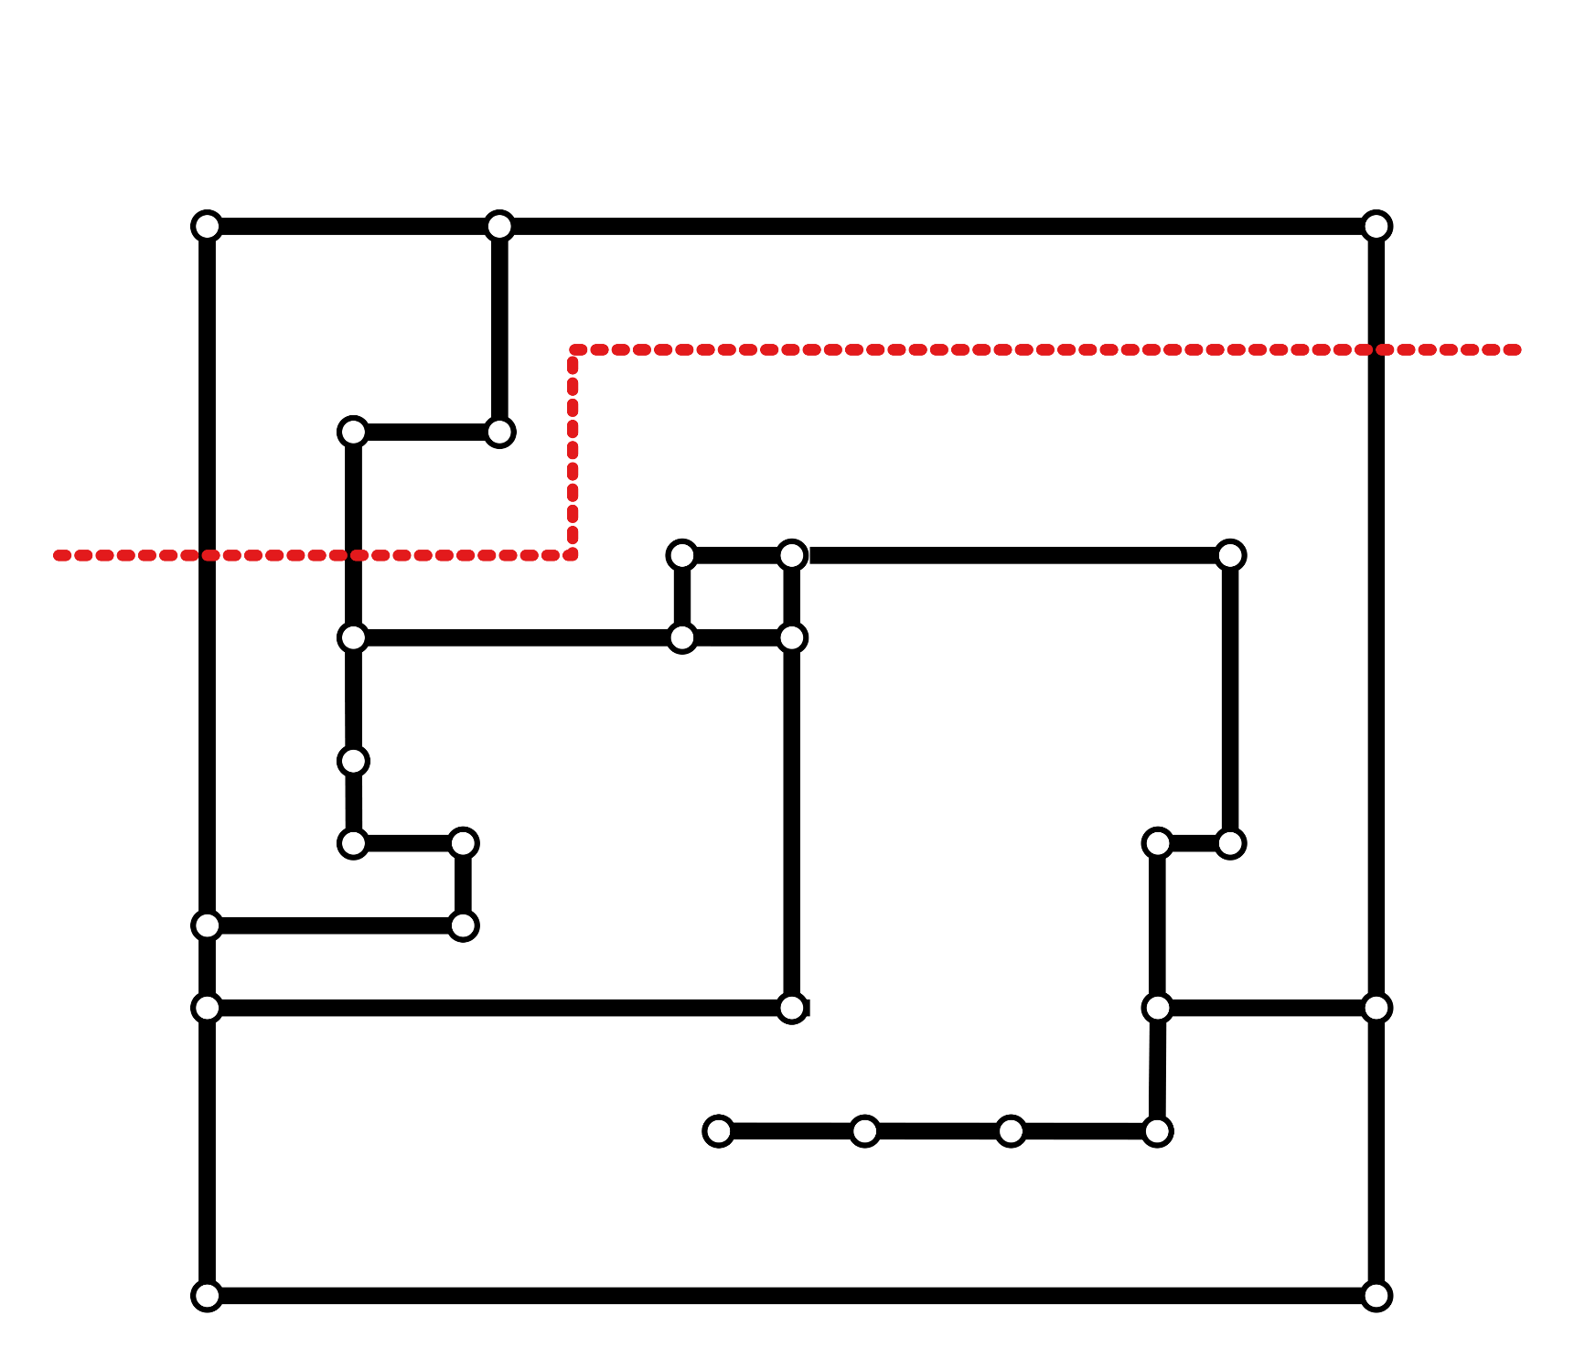
Wires
Notes:
Mention wire (1) partitions vertices, (2) crosses edges in same order.

Slide 13
Wires

Slide 14
Spirality
The spirality $s(ℓ_{i})=\sum_{j=1}^{i−1}{b_{j}}$.
Where $b_{j}$ is the orientation of the bend between $ℓ_{j}$ and $ℓ_{j+1}$.
And $b_{j}=1$ for a left turn, $b_{j}=−1$ for a right turn.
$$s(ℓ_{6})=−1$$
$$s(ℓ_{3})=2$$
$$s(ℓ_{2})=1$$
$$s(ℓ_{13})=0$$
$$s(ℓ_{1})=0$$

Slide 15
Spirality
Idea
We can reduce the maximum (absolute) spirality by one with one linear morph.
$$s(ℓ_{6})=−1$$
$$s(ℓ_{3})=2$$
$$s(ℓ_{2})=1$$
$$s(ℓ_{13})=0$$
$$s\left(ℓ_{7}\right)=−2$$
$$s(ℓ_{11})=2$$
$$s(ℓ_{1})=0$$

Slide 16
Spirality

Slide 17
Spirality
Connected graph [SoCG 2018]
Spirality $s = O(n)$
Morph using wires [SoCG 2018]
$O(s)$ linear morphs
Disconnected graph [SoCG 2018]
Spirality $s = O(n\sqrt{n})$
Disconnected graph [GD 2019]
Spirality $s = O(n)$

Slide 18
Spirality
DISCONNECTED
Disconnected graph [GD 2019]
Spirality $s = O(n)$
Input
Insert shortest lr-wire
Insert shortest tb-wire
Spirality O(n)

Slide 19
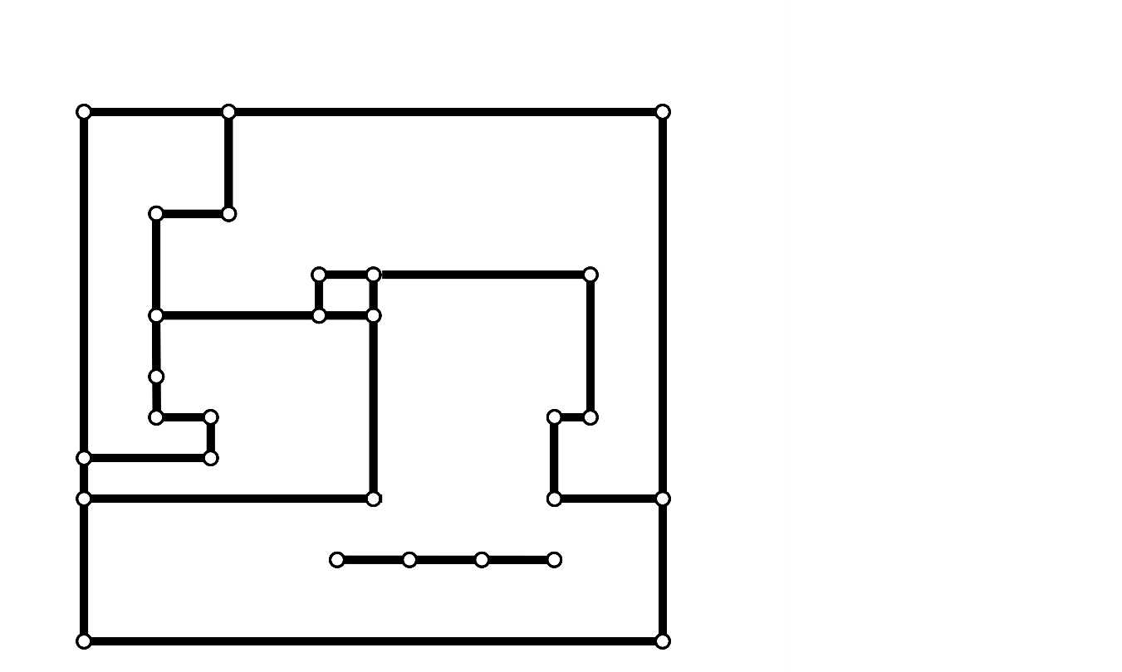
Disconnected

Slide 20
Disconnected
Insert the wires in $Γ_{I}$ one-by-one
Take the shortest wire with respect to the previously inserted wires

Slide 21
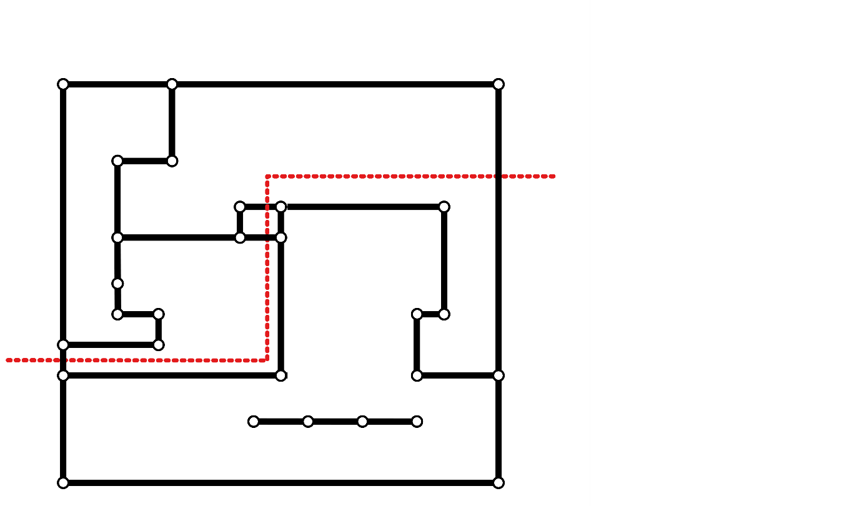
Disconnected
Insert the wires in $Γ_{I}$ one-by-one
Take the shortest wire with respect to the previously inserted wires

Slide 22
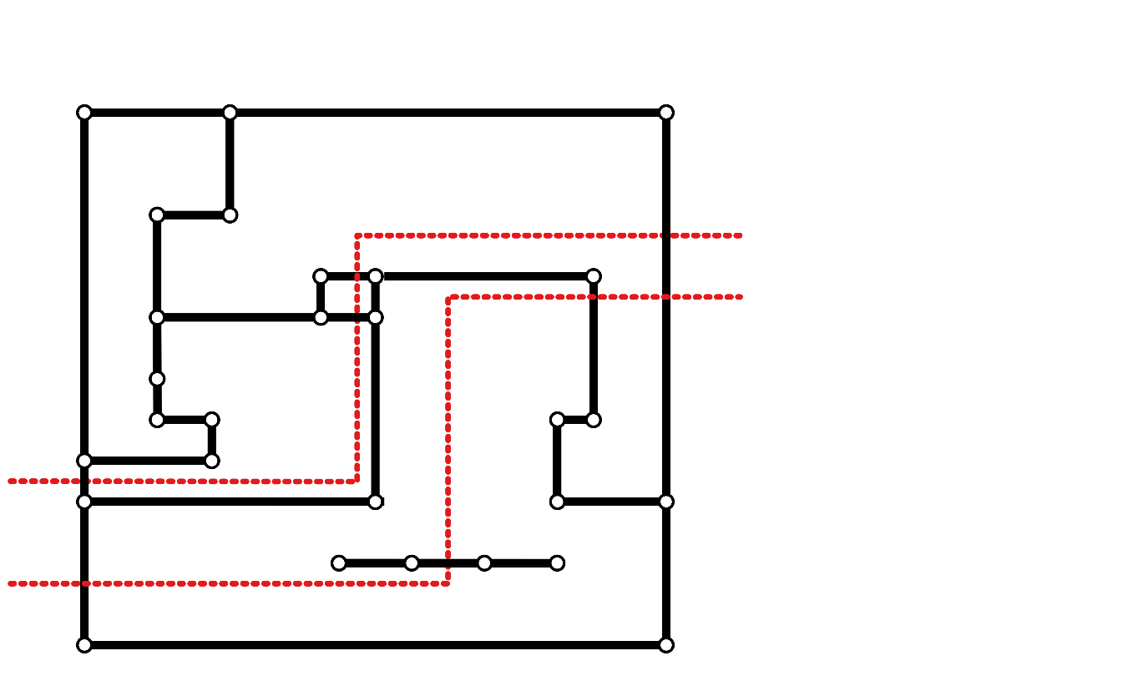
Disconnected
Insert the wires in $Γ_{I}$ one-by-one
Take the shortest wire with respect to the previously inserted wires

Slide 23
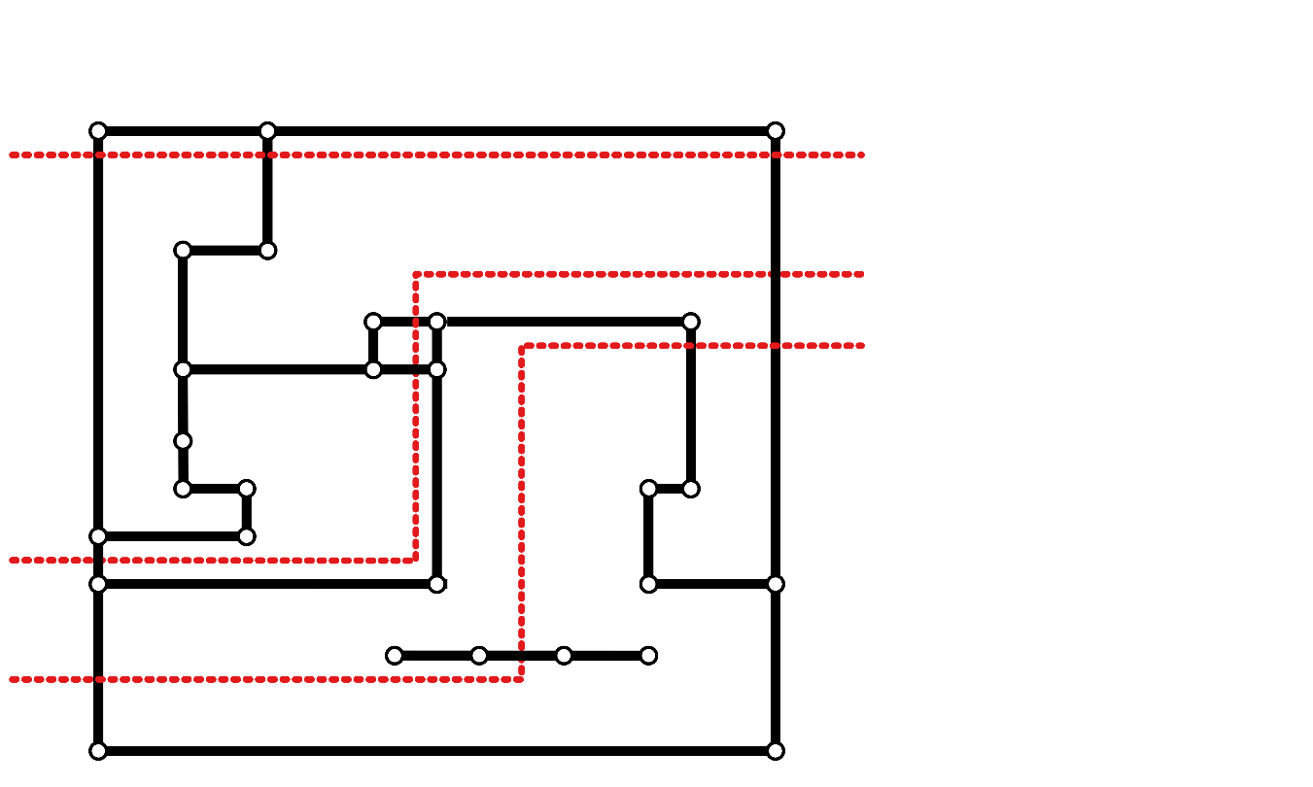
Disconnected
Insert the wires in $Γ_{I}$ one-by-one
Take the shortest wire with respect to the previously inserted wires

Slide 24
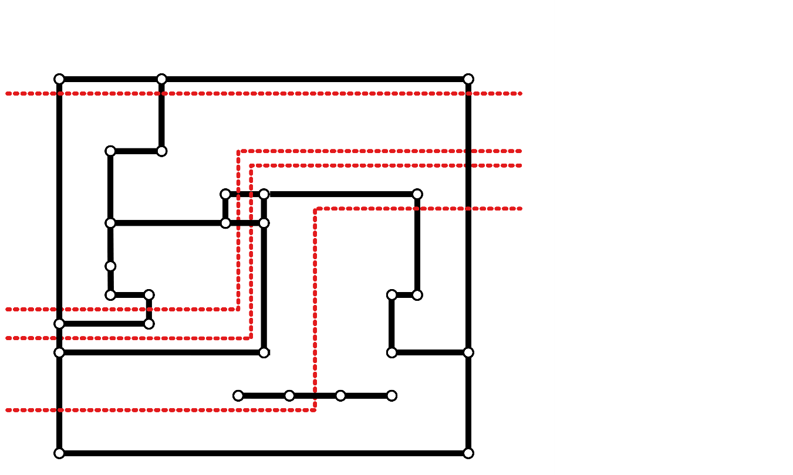
Disconnected
Insert the wires in $Γ_{I}$ one-by-one
Take the shortest wire with respect to the previously inserted wires

Slide 25
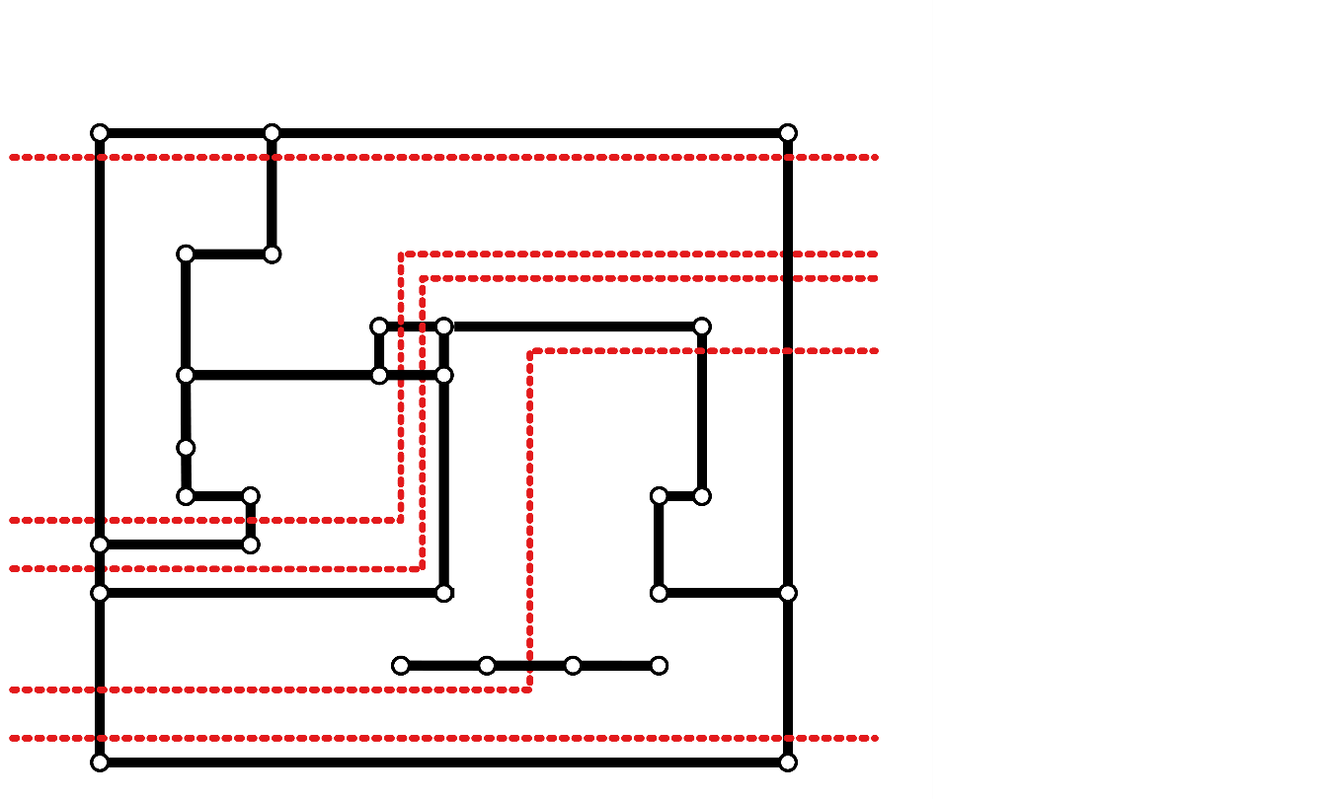
Disconnected
Insert the wires in $Γ_{I}$ one-by-one
Take the shortest wire with respect to the previously inserted wires

Slide 26
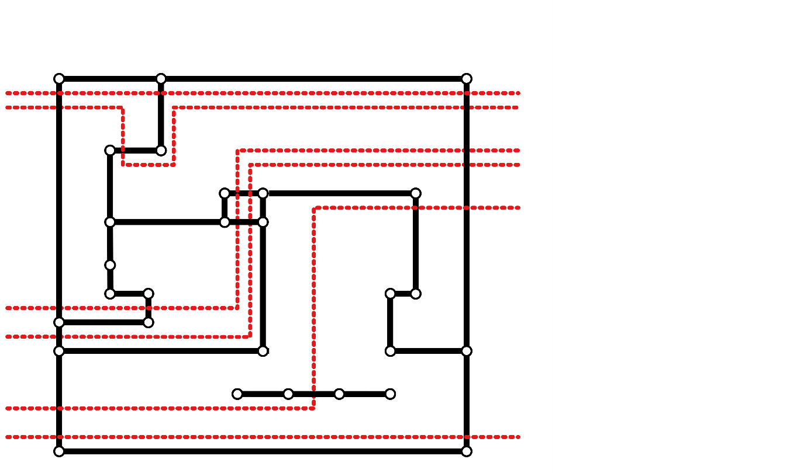
Disconnected
Insert the wires in $Γ_{I}$ one-by-one
Take the shortest wire with respect to the previously inserted wires

Slide 27
Disconnected
Some observations:
A wire can have complexity $Ω(n^{2})$.
A wire should partition the vertices identically.
A wire crosses an edge at most once.
A pair of lr-wires does not cross.

Slide 28
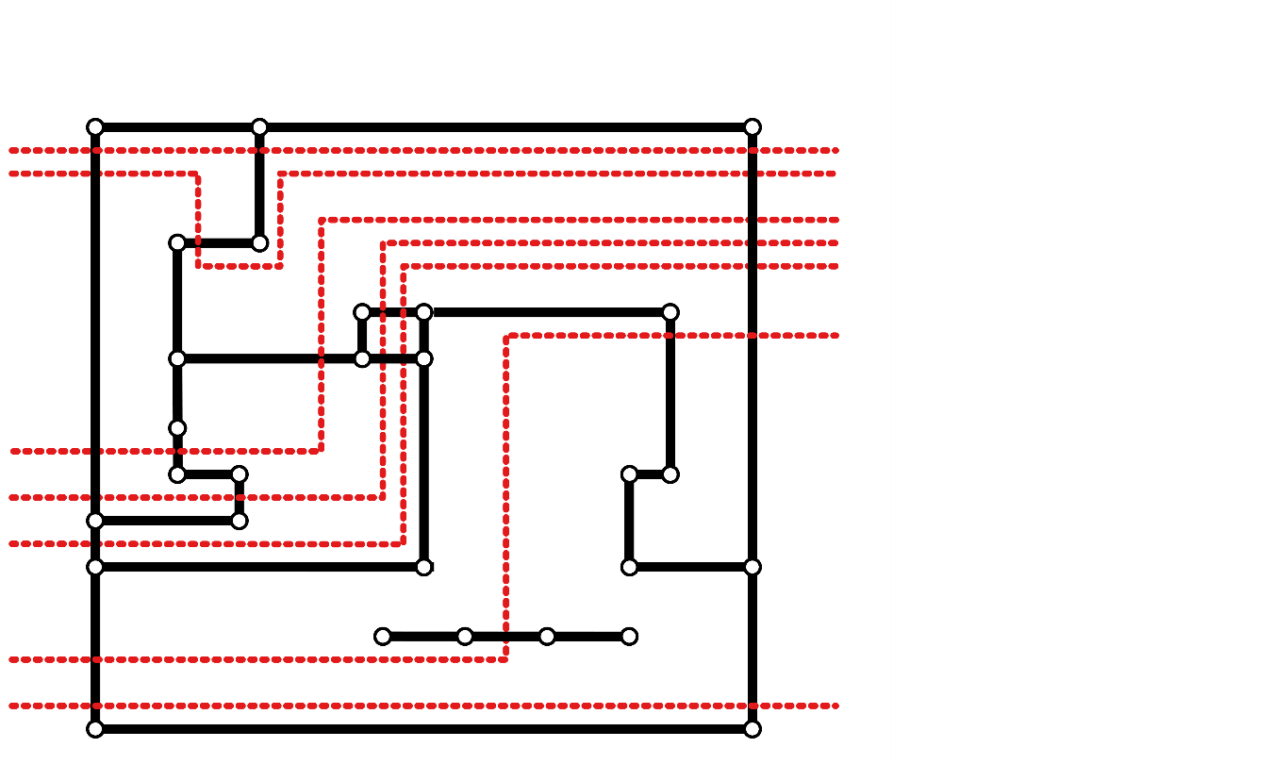
Disconnected
Some observations:
A wire can have complexity $Ω(n^{2})$.
A wire should partition the vertices identically.
A wire crosses an edge at most once.
A pair of lr-wires does not cross.

Slide 29
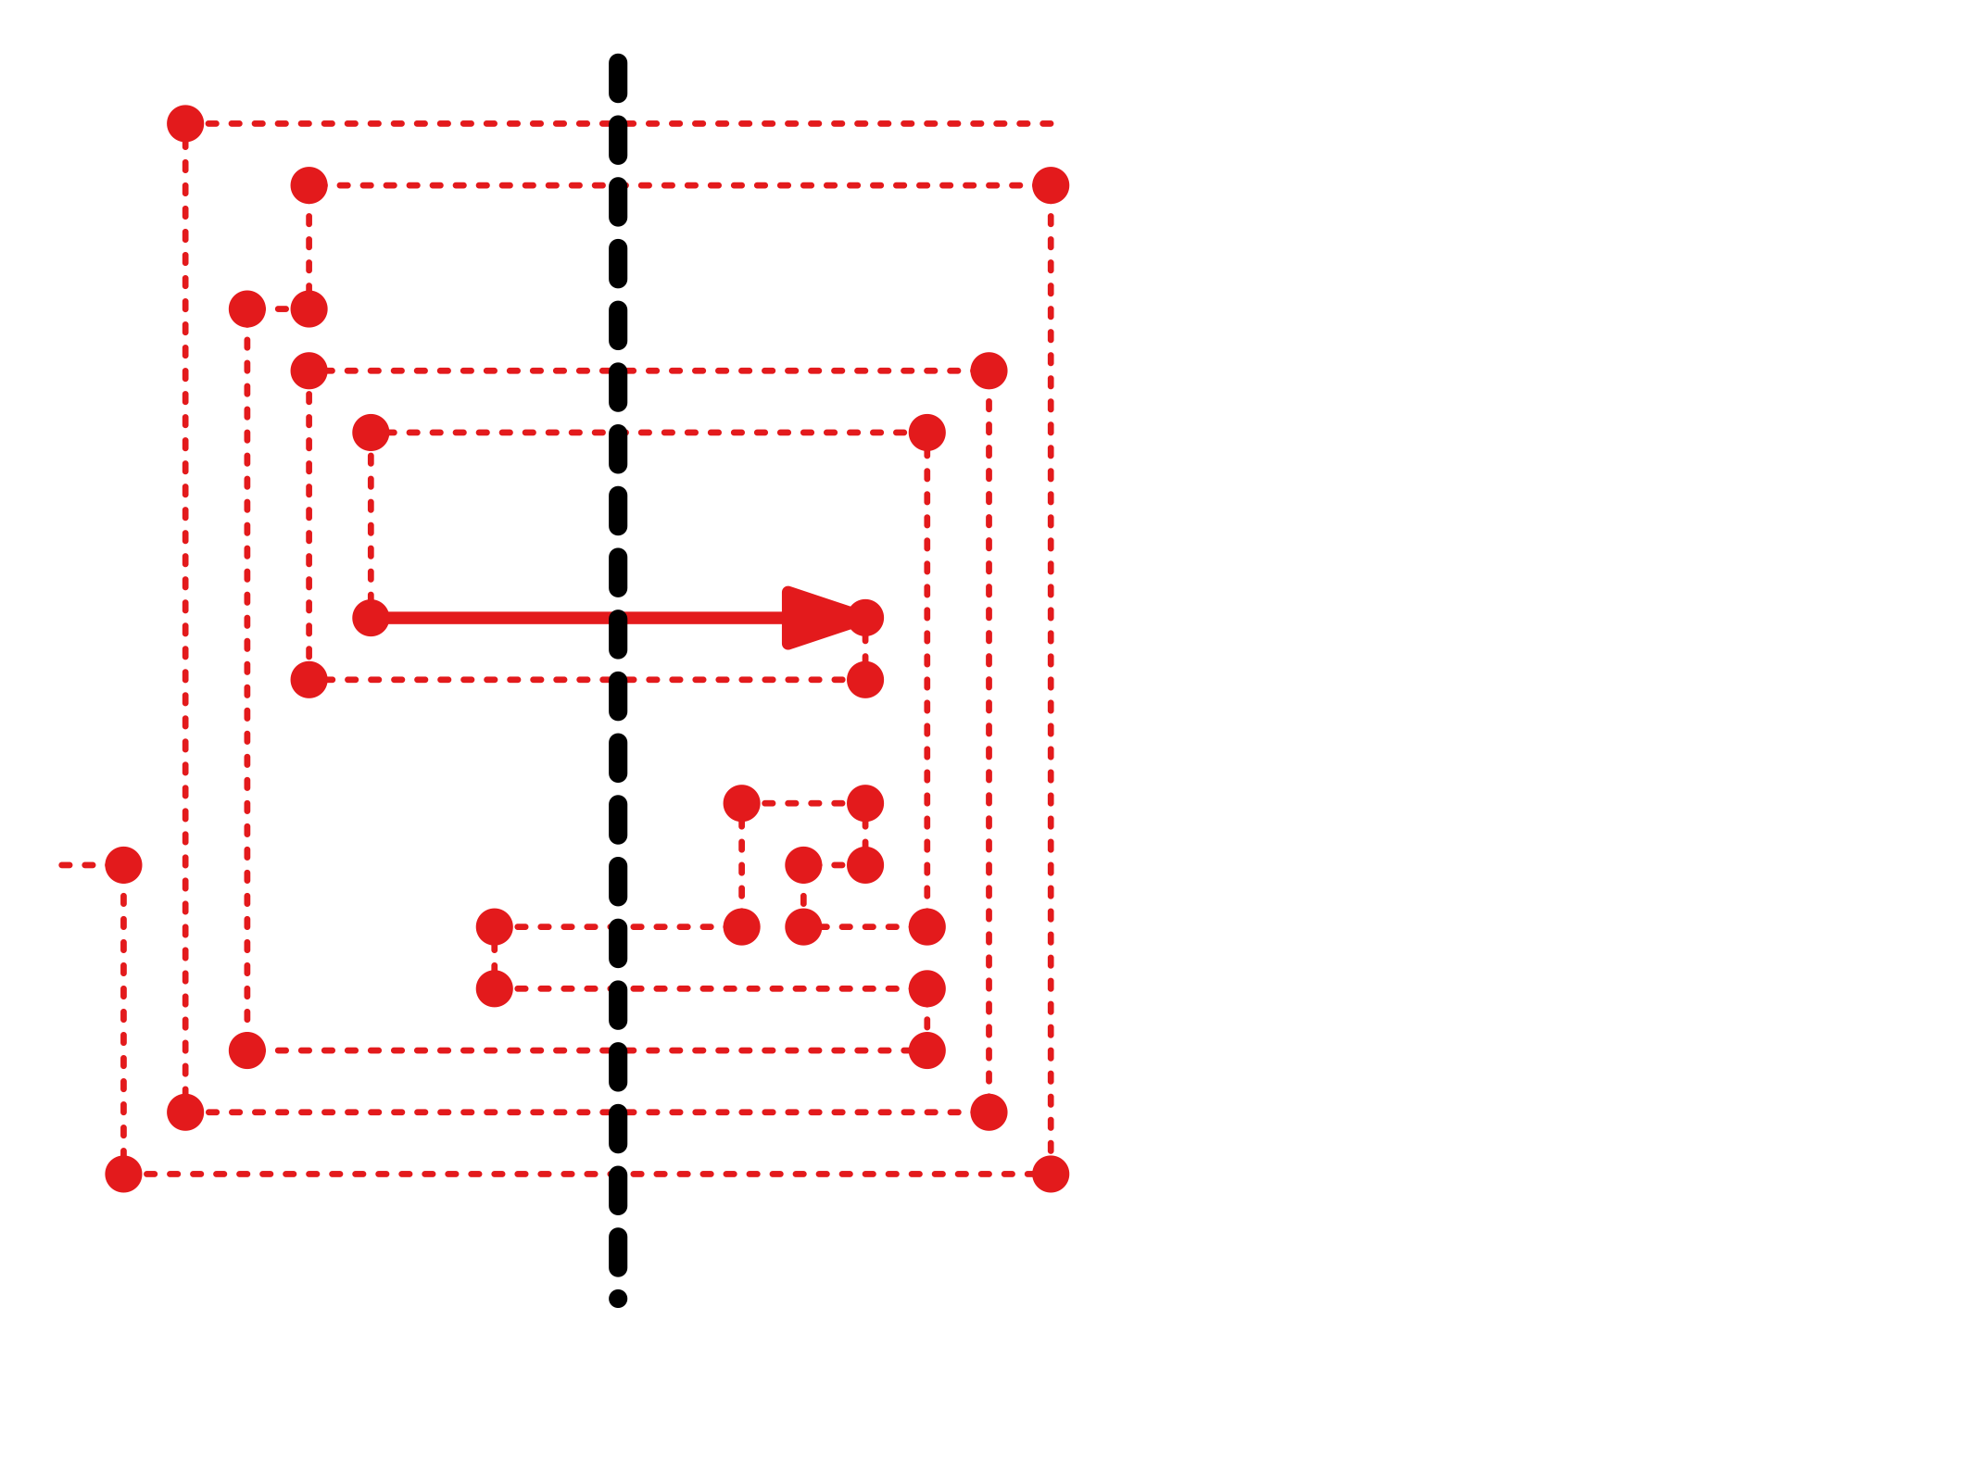
Disconnected
Consider a vertical line $L$ through the right-oriented link $ℓ_{s}$ with spirality $s$.
$$L$$
$$ℓ_{s}$$

Slide 30
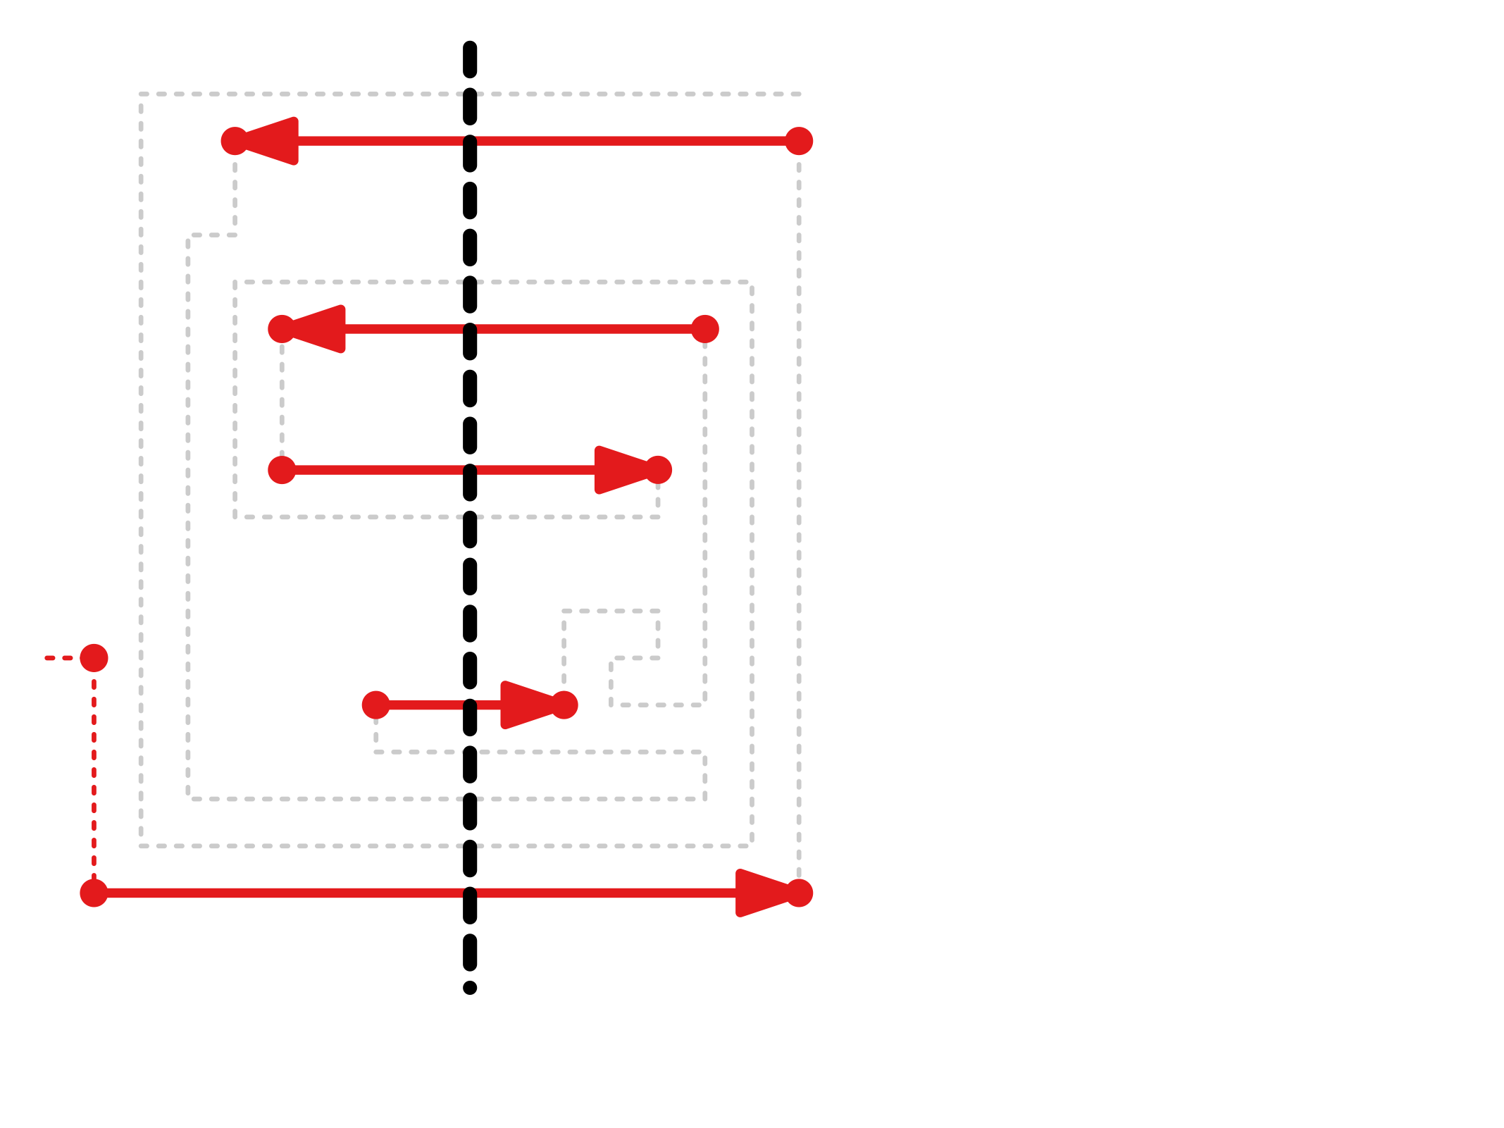
Disconnected
Consider a vertical line $L$ through the right-oriented link $ℓ_{s}$ with spirality $s$.
There exists a set of $Θ\left(s\right)$ links crossing $L$.
$$L$$
$$ℓ_{s}$$

Slide 31
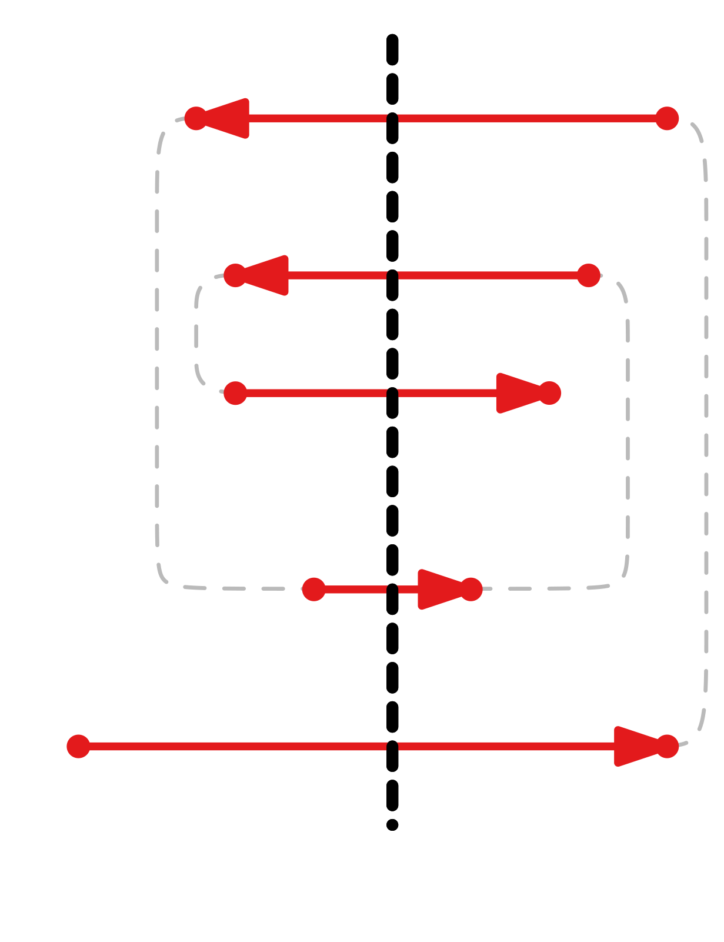
Disconnected
Consider a vertical line $L$ through the right-oriented link $ℓ_{s}$ with spirality $s$.
There exists a set of $Θ\left(s\right)$links crossing $L$ that form a spiral surrounding $ℓ_{s}$.
$$L$$
$$ℓ_{s}$$

Slide 32
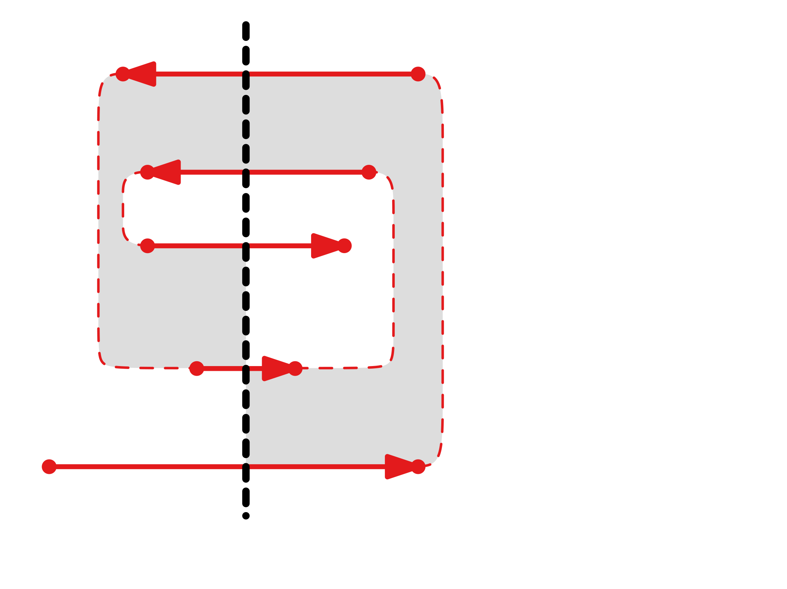
Disconnected
Consider a vertical line $L$ through the right-oriented link $ℓ_{s}$ with spirality $s$.
There exists a set of $Θ\left(s\right)$links crossing $L$ that form a spiral surrounding $ℓ_{s}$.
There exist $Θ\left(s\right)$layers surrounding $ℓ_{s}$.
$$L$$

Slide 33
Disconnected
Consider a vertical line $L$ through the right-oriented link $ℓ_{s}$ with spirality $s$.
There exists a set of $Θ\left(s\right)$links crossing $L$ that form a spiral surrounding $ℓ_{s}$.
There exist $Θ\left(s\right)$layers surrounding $ℓ_{s}$.
$O(n)$ layers contain a part of the drawing.
$$L$$

Slide 34
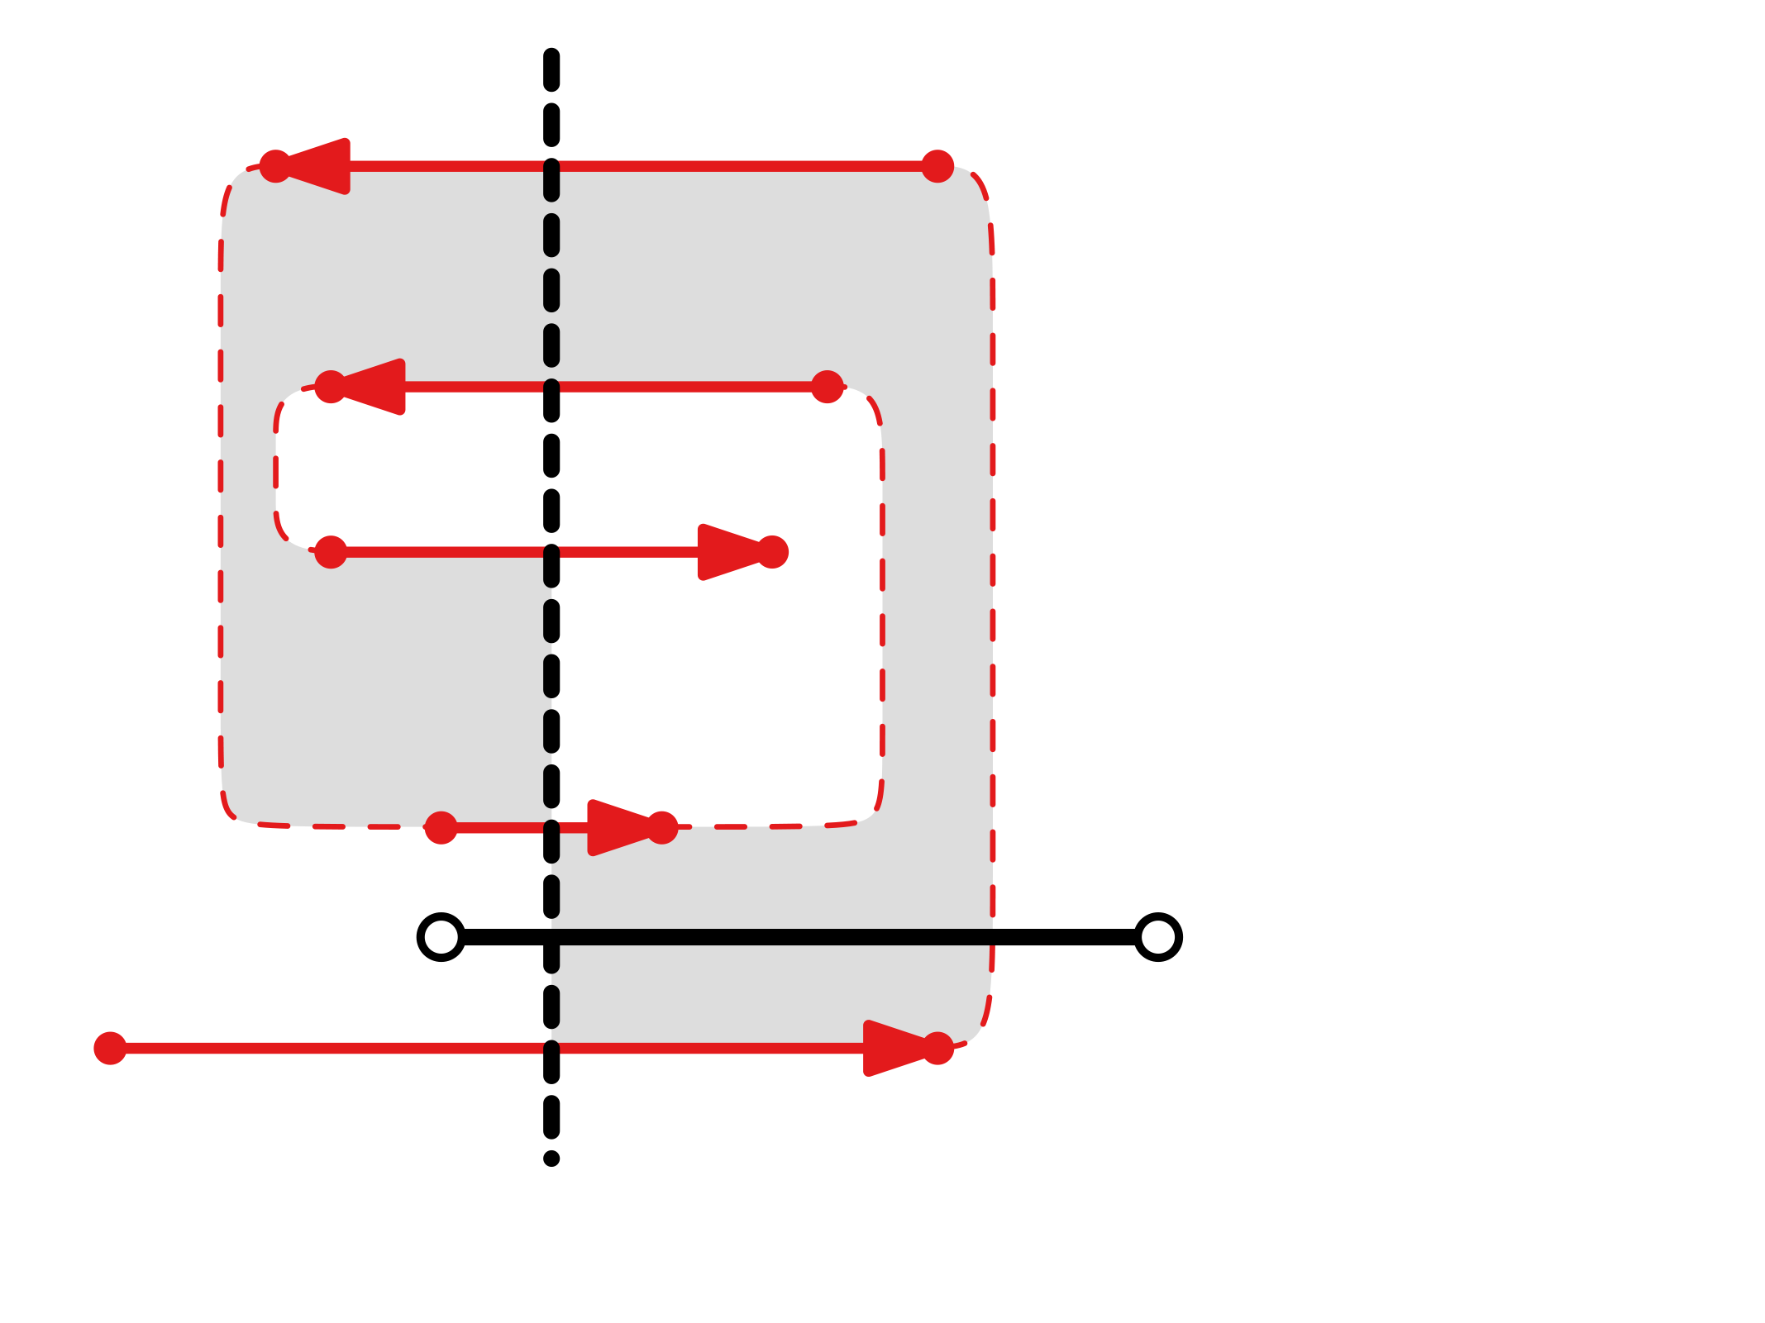
Disconnected
Consider a vertical line $L$ through the right-oriented link $ℓ_{s}$ with spirality $s$.
There exists a set of $Θ\left(s\right)$links crossing $L$ that form a spiral surrounding $ℓ_{s}$.
There exist $Θ\left(s\right)$layers surrounding $ℓ_{s}$.
$O(n)$ layers contain a part of the drawing.
$$L$$

Slide 35
Disconnected
Consider a vertical line $L$ through the right-oriented link $ℓ_{s}$ with spirality $s$.
There exists a set of $Θ\left(s\right)$links crossing $L$ that form a spiral surrounding $ℓ_{s}$.
There exist $Θ\left(s\right)$layers surrounding $ℓ_{s}$.
$O(n)$ layers contain a part of the drawing.
No other layers exist as the wires are shortest.
$$L$$

Slide 36
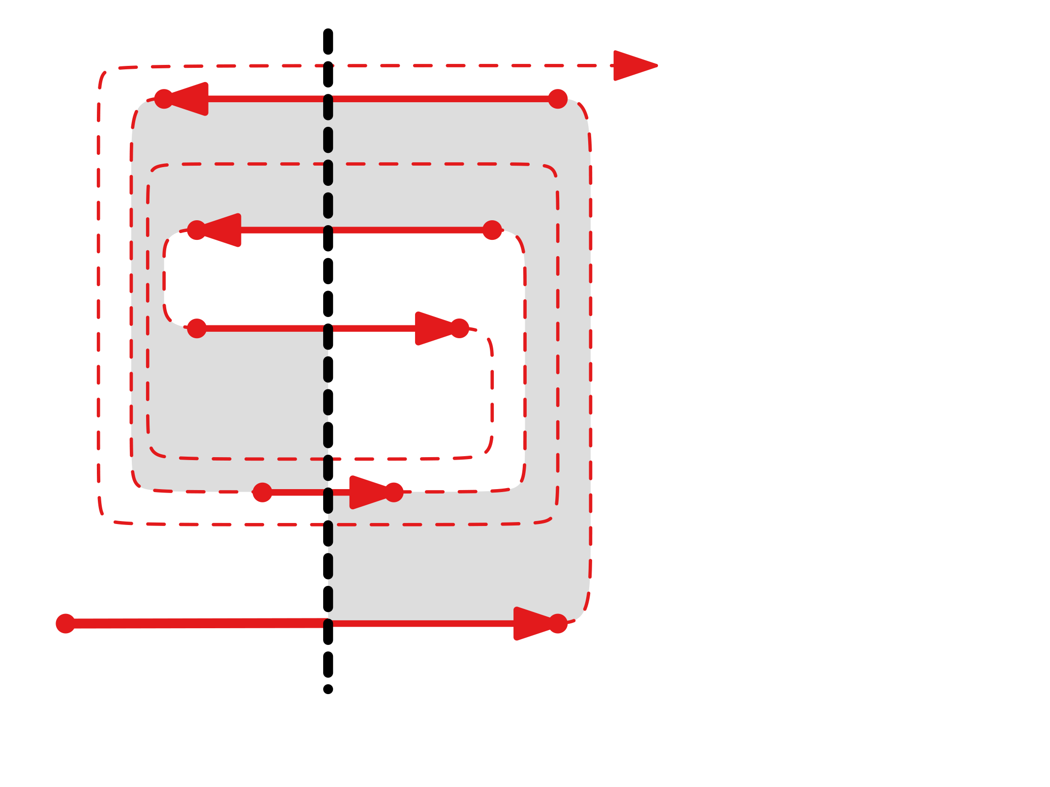
Disconnected
Consider a vertical line $L$ through the right-oriented link $ℓ_{s}$ with spirality $s$.
There exists a set of $Θ\left(s\right)$links crossing $L$ that form a spiral surrounding $ℓ_{s}$.
There exist $Θ\left(s\right)$layers surrounding $ℓ_{s}$.
$O(n)$ layers contain a part of the drawing.
No other layers exist as the wires are shortest.
$$L$$

Slide 37
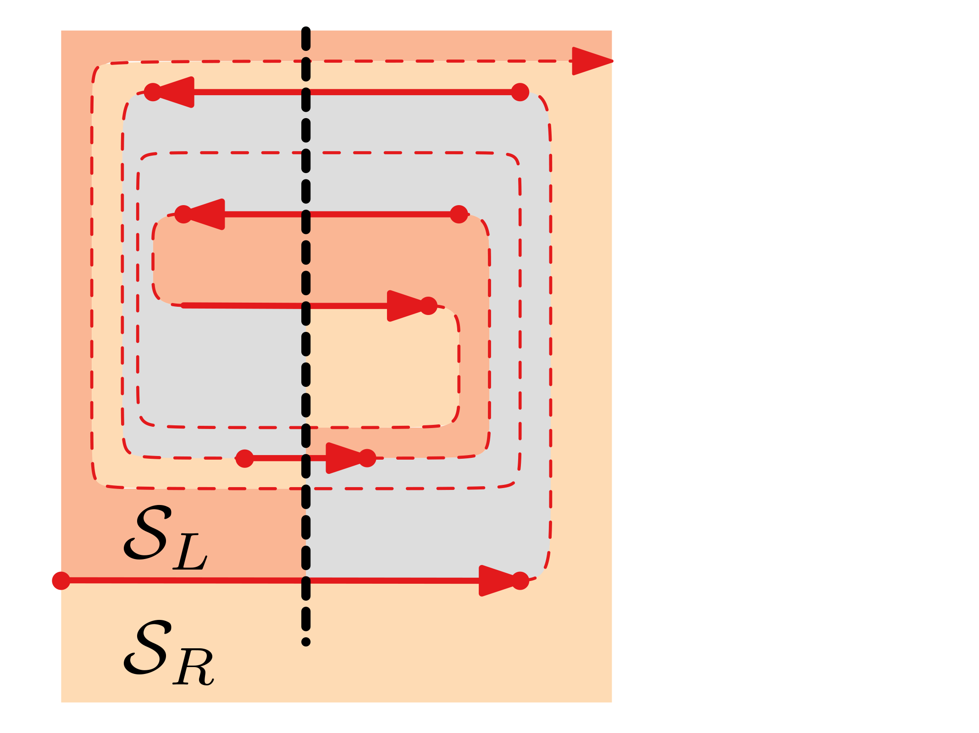
Disconnected
Consider a vertical line $L$ through the right-oriented link $ℓ_{s}$ with spirality $s$.
There exists a set of $Θ\left(s\right)$links crossing $L$ that form a spiral surrounding $ℓ_{s}$.
There exist $Θ\left(s\right)$layers surrounding $ℓ_{s}$.
$O(n)$ layers contain a part of the drawing.
No other layers exist as the wires are shortest.
$$L$$

Slide 38
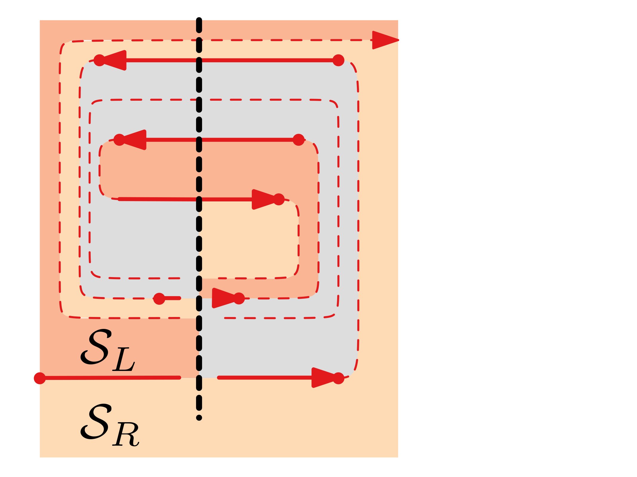
Disconnected
Consider a vertical line $L$ through the right-oriented link $ℓ_{s}$ with spirality $s$.
There exists a set of $Θ\left(s\right)$links crossing $L$ that form a spiral surrounding $ℓ_{s}$.
There exist $Θ\left(s\right)$layers surrounding $ℓ_{s}$.
$O(n)$ layers contain a part of the drawing.
No other layers exist as the wires are shortest.
$$L$$

Slide 39
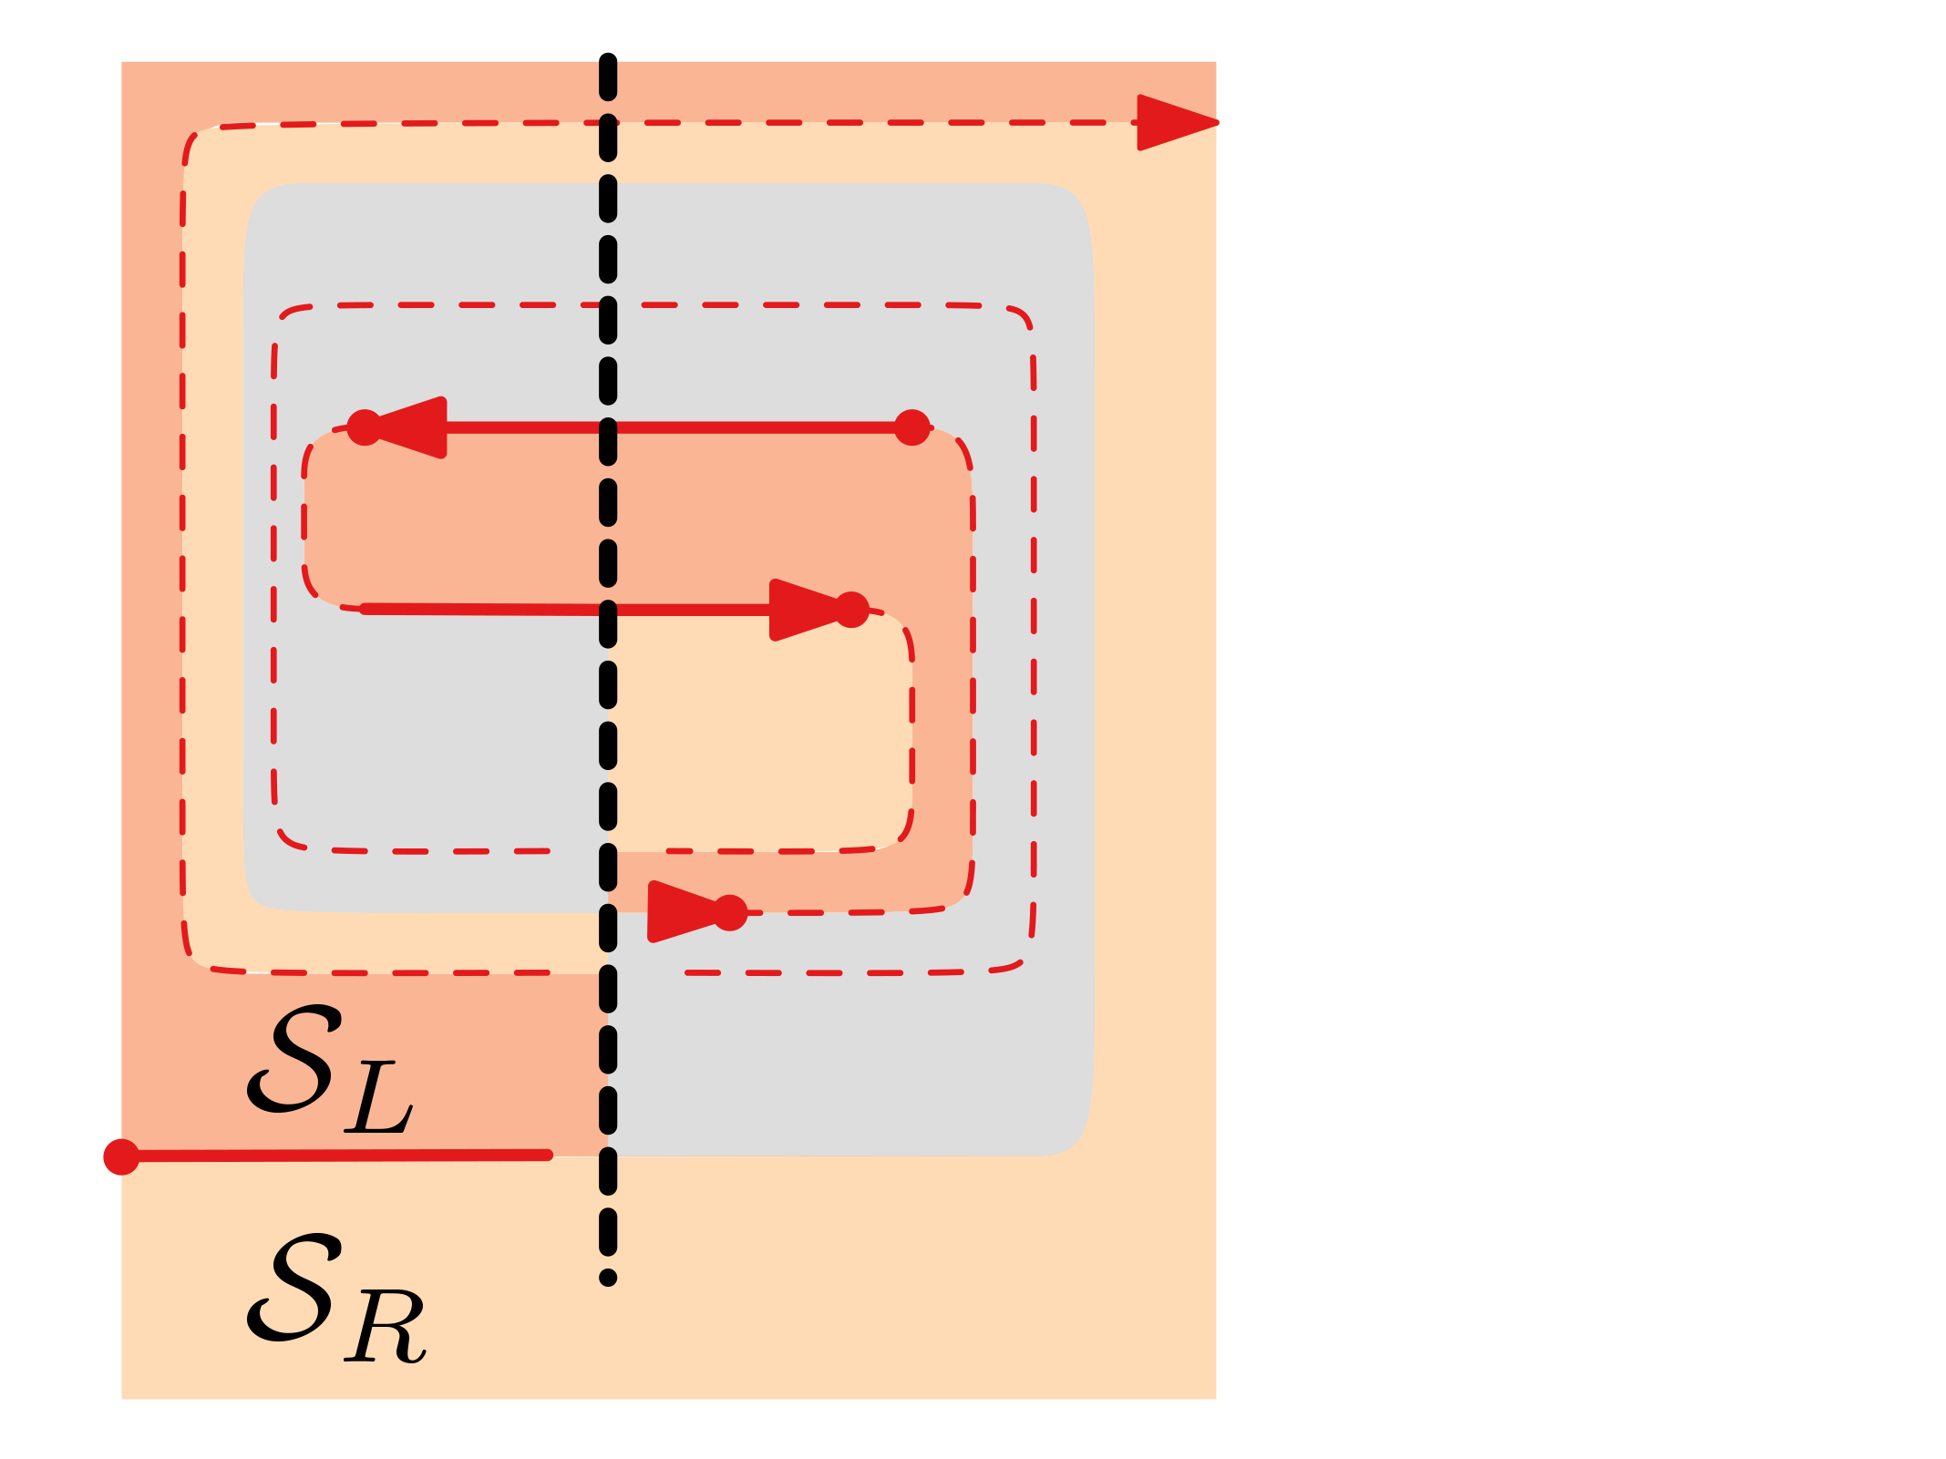
Disconnected
Consider a vertical line $L$ through the right-oriented link $ℓ_{s}$ with spirality $s$.
There exists a set of $Θ\left(s\right)$links crossing $L$ that form a spiral surrounding $ℓ_{s}$.
There exist $Θ\left(s\right)$layers surrounding $ℓ_{s}$.
$O(n)$ layers contain a part of the drawing.
No other layers exist as the wires are shortest.
$$L$$

Slide 40
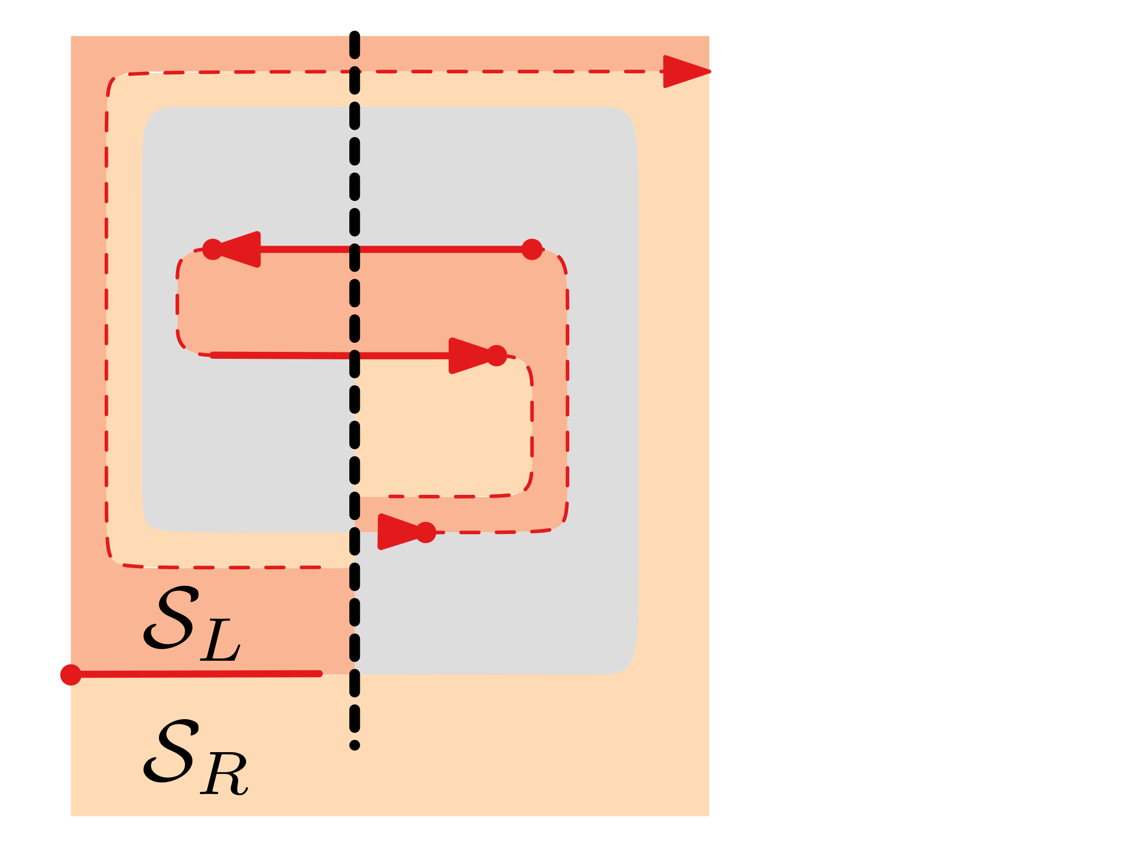
Disconnected
Consider a vertical line $L$ through the right-oriented link $ℓ_{s}$ with spirality $s$.
There exists a set of $Θ\left(s\right)$links crossing $L$ that form a spiral surrounding $ℓ_{s}$.
There exist $Θ\left(s\right)$layers surrounding $ℓ_{s}$.
$O(n)$ layers contain a part of the drawing.
No other layers exist as the wires are shortest.
$$L$$

Slide 41
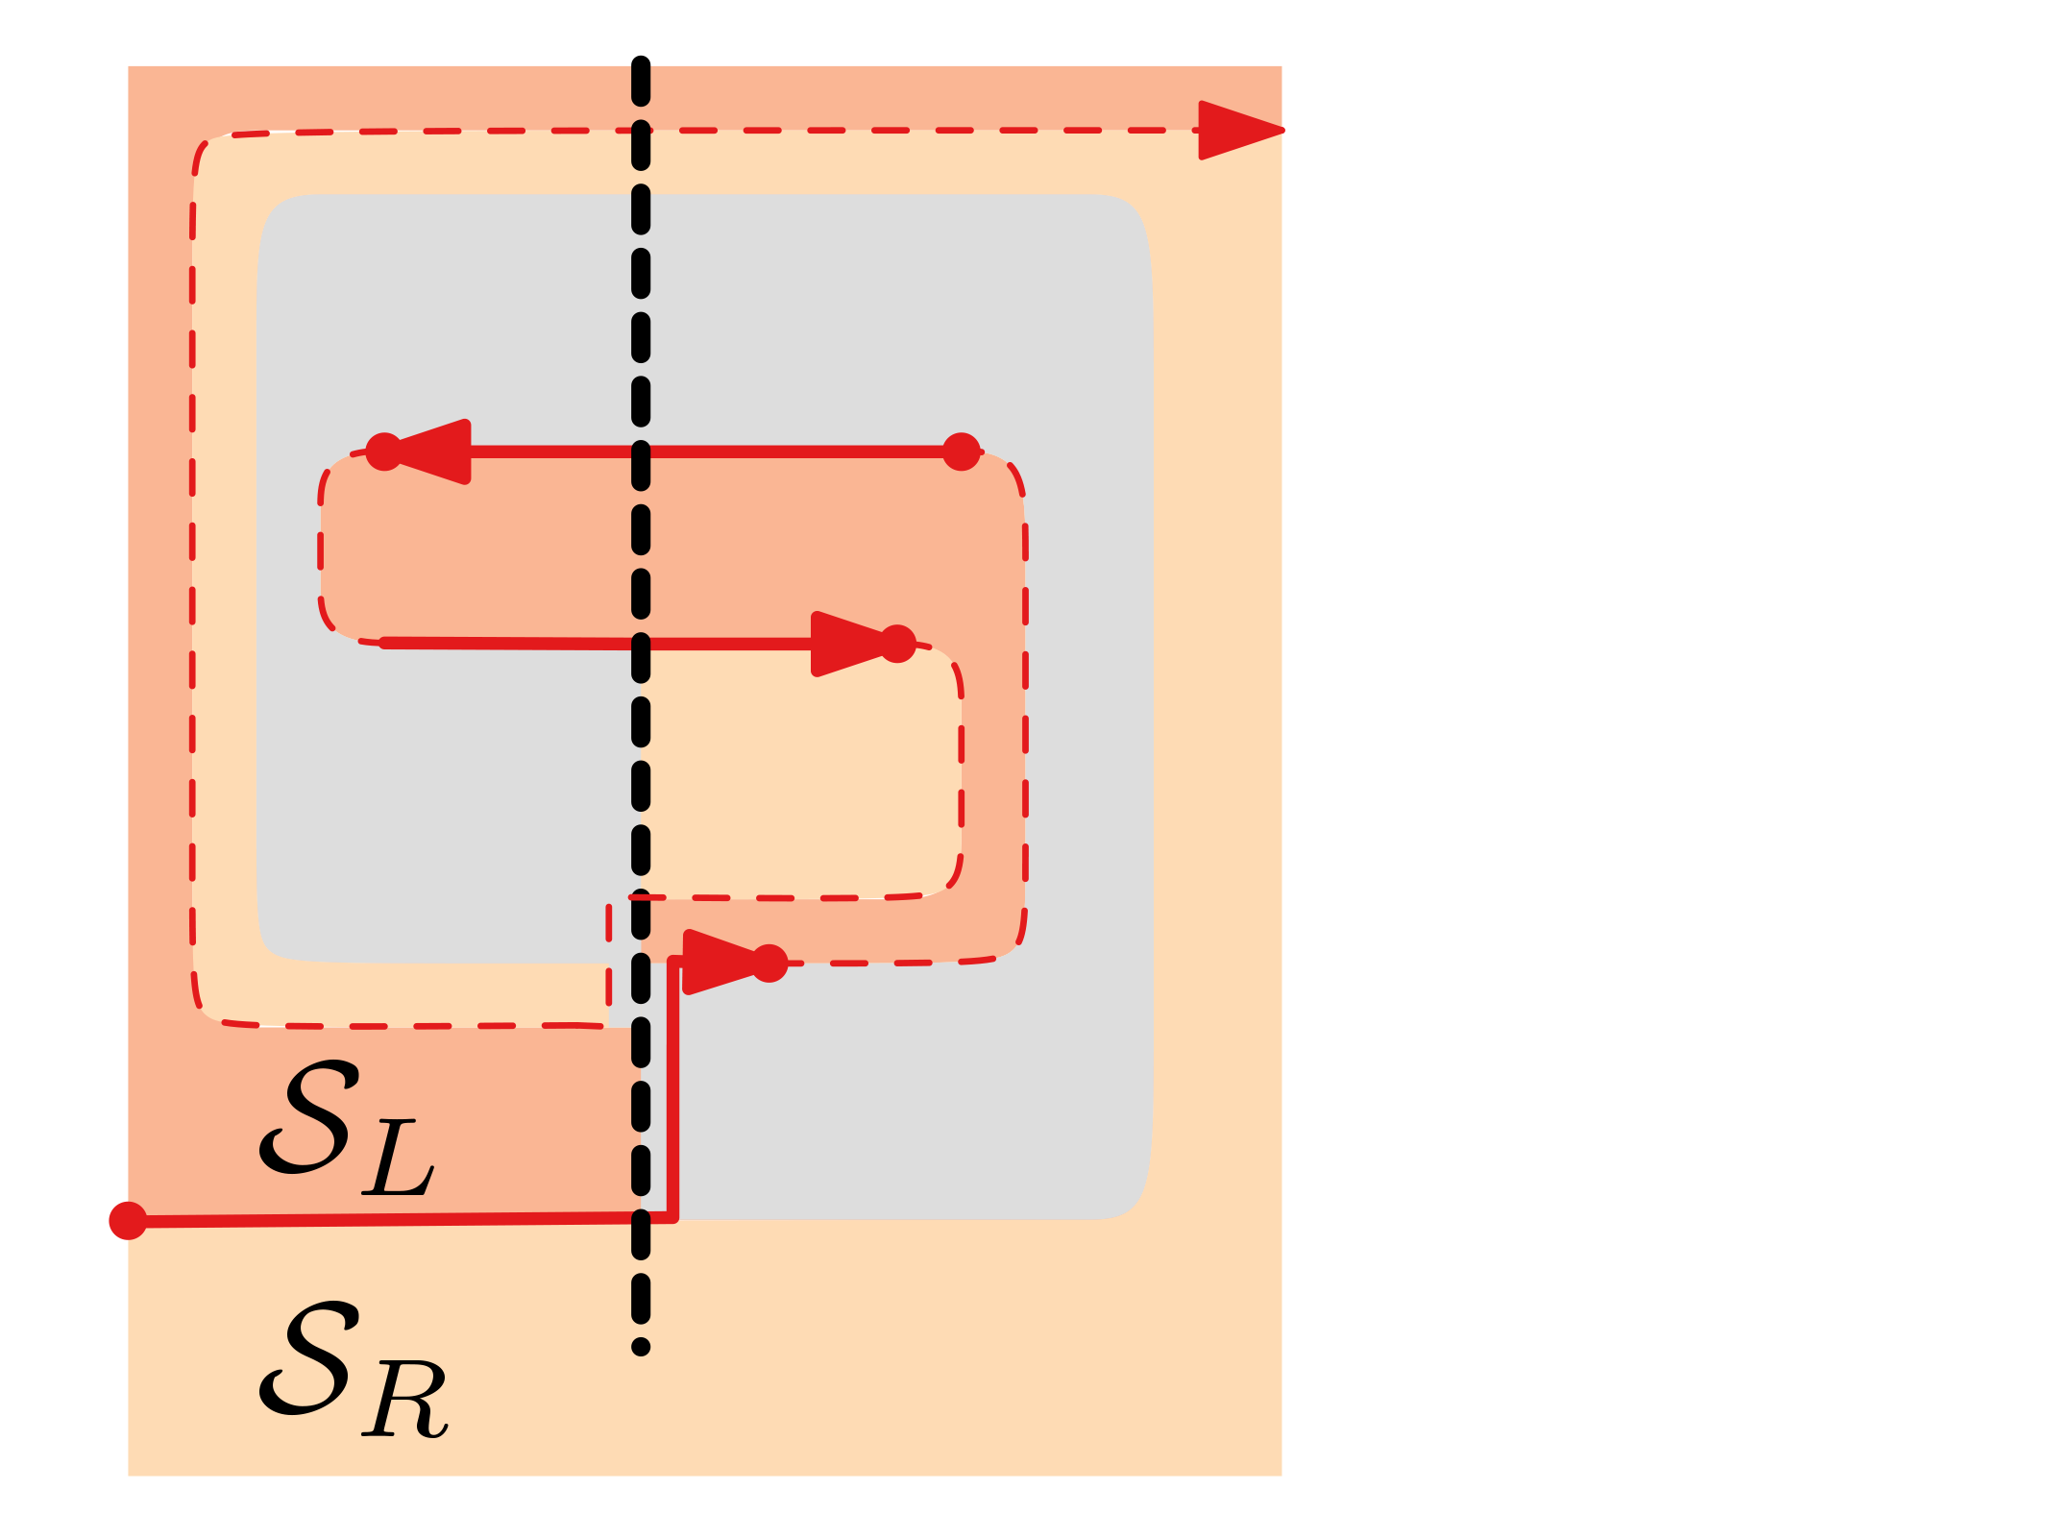
Disconnected
Consider a vertical line $L$ through the right-oriented link $ℓ_{s}$ with spirality $s$.
There exists a set of $Θ\left(s\right)$links crossing $L$ that form a spiral surrounding $ℓ_{s}$.
There exist $Θ\left(s\right)$layers surrounding $ℓ_{s}$.
$O(n)$ layers contain a part of the drawing.
No other layers exist as the wires are shortest.
$s=O(n)$
$$L$$

Slide 42
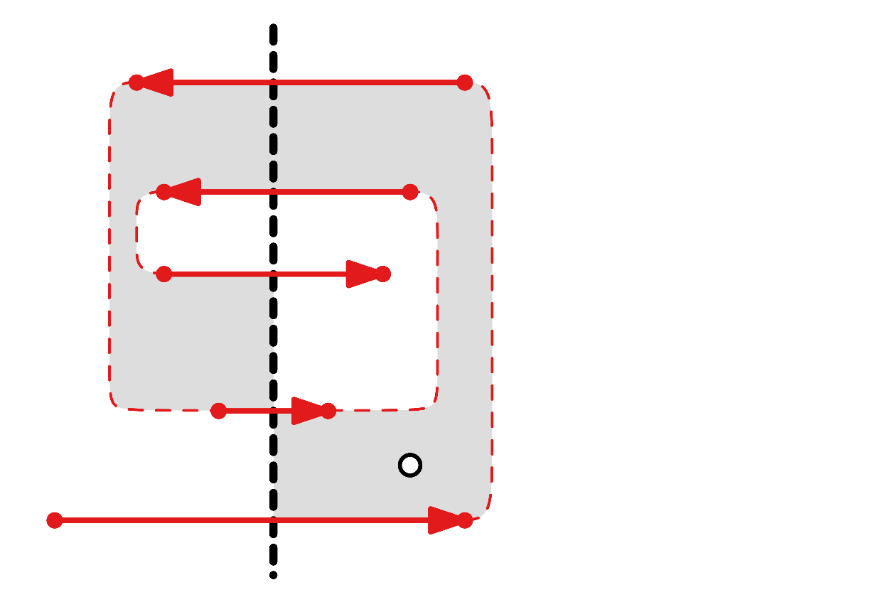
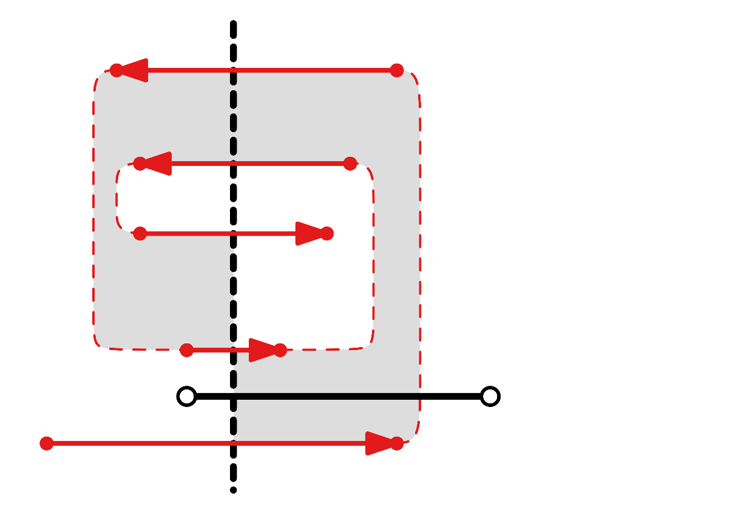
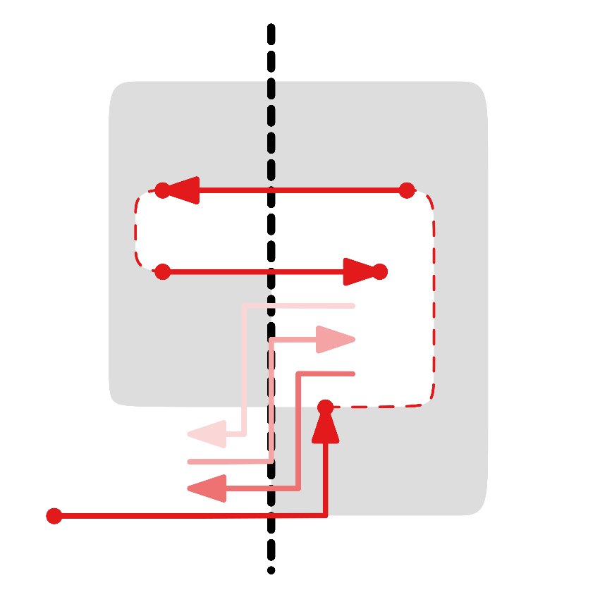
Disconnected
There exists a set of wires with maximum spirality $O(n)$.
Thus using [SoCG 2018] directly gives:
$O\left(s\right)=O(n)$linear morphs
maintaining planarity, orthogonality, and linear complexity

Slide 43
Disconnected
Connected graph [SoCG 2018]
Spirality $s = O(n)$
Morph using wires [SoCG 2018]
$O(s)$ linear morphs
Batched linear morphs [GD 2019]
$s+1$ linear morphs
Disconnected graph [SoCG 2018]
Spirality $s = O(n\sqrt{n})$
Disconnected graph [GD 2019]
Spirality $s = O(n)$

Slide 44
BATCHED
Batched linear morphs [GD 2019]
$s+1$ linear morphs
Input
Compute morph
[SoCG 2018]
Straighten drawing
Combine all
max. spirality
linear morphs
Output

Slide 45
Batched
[SoCG 2018] |  | [GD 2019]
While reducing spirality by one, we can combine all horizontal (vertical) linear slides. |  | While reducing spirality by one, we can combine all linear slides.
We require $O\left(s\right)$ additional organizational linear morphs. |  | We require $1$ additional organizational linear morphs.
Total: $O(s)$ linear morphs |  | Total: $s+1$ linear morphs

Slide 46
Batched
[SoCG 2018] |  | [GD 2019]
While reducing spirality by one, we can combine all horizontal (vertical) linear slides. |  | While reducing spirality by one, we can combine all linear slides.
We require $O\left(s\right)$ additional organizational linear morphs. |  | We require $1$ additional organizational linear morphs.
Total: $O(s)$ linear morphs |  | Total: $s+1$ linear morphs

Slide 47
Batched
[SoCG 2018] |  | [GD 2019]
While reducing spirality by one, we can combine all horizontal (vertical) linear slides. |  | While reducing spirality by one, we can combine all linear slides.
We require $O\left(s\right)$ additional organizational linear morphs. |  | We require $1$ additional organizational linear morphs.
Total: $O(s)$ linear morphs |  | Total: $s+1$ linear morphs

Slide 48
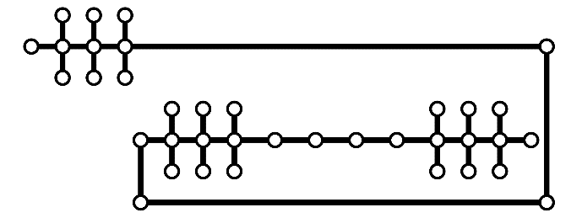
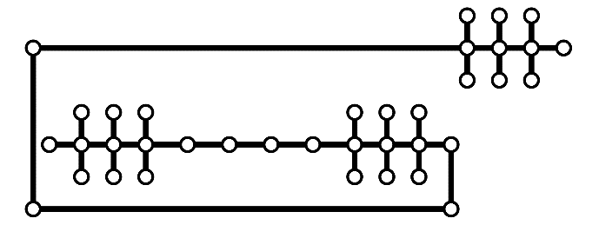
‘ Proof ’
[SoCG 2018]

Slide 49
‘ Proof ’
[GD 2019]

Slide 50
Summary
Morphing two orthogonal planar drawings of the same graph.
Maintain orthogonality, planarity, linear complexity.
For two drawings of a (dis)connected planar graph: $s+1$ linear morphs
[SoCG 2018] [GD 2019]

