Slide 1



Stress-Plus-X (SPX) Graph Layout
27th International Symposium
On
Graph Drawing and Network Visualization
Reyan Ahmed, Felice De Luca, Sabin Devkota, Katherine E. Isaacs, Stephen Kobourov
Computer Science, University of Arizona
Prague, Czech Republic
Sep 19, 2019

Slide 2
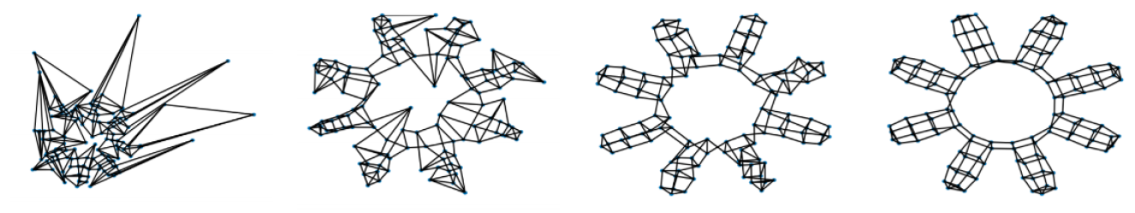
SPX optimizes multiple criteria simultaneously
Most graph drawing algorithms optimize one criterion
The layouts produced may be deficient in other criteria
(a)
(b)
(c)
(d)
Different layouts of a graph from gd 2018 contest on crossing angle maximization (automatic)
(a) Bekos et al. 2018 (Tübingen), winner 2018 contest
(b) Demel et al. 2018 (KIT), winner 2017 contest
(c, d) SPX with different balance of stress, crossing angle, and edge crossings
Notes:
Tubingen won in 2018
KIT won in 2017
there was a GD contest for several years with the goal to minimize crossings angles
We participated and never won
but in the process realized that what’s often missing is a way to obtain good drawings of graphs that balance multiple goals/criteria

Slide 3
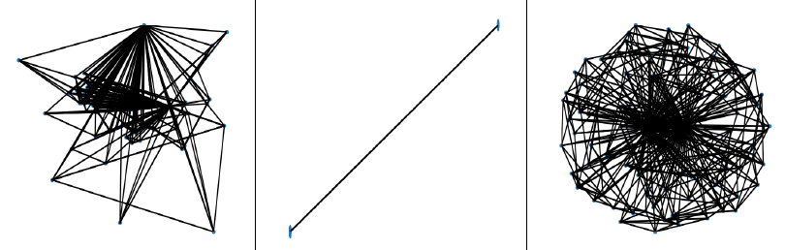
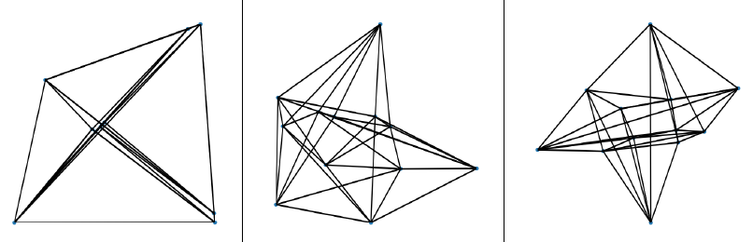
Don’t let perfect be the enemy of good
Optimizing single criterion can result in unreadable drawings
Tübingen
KIT
SPX
Best crossing angle (center) yields a large drawing area
Best crossing angle (left) yields poor vertex resolution

Slide 4
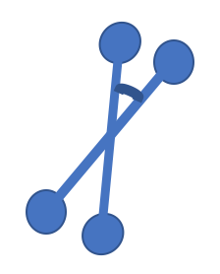
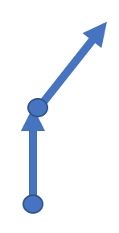

Stress-Plus-X (SPX) Framework
SPX simultaneously optimizes
Stress
+ other readability criteria (X)
X can be any combination of criteria
We illustrate SPX with the following criteria:
,
,
Number of edge crossings
Crossing angle
Upward drawing
for DAGs
Notes:
We formulate graph layout as
a joint optimization of Stress + other readability criteria (X)
illustrated here with X=crossings,
or X=angles, or X=upwardness, or X=combination of crossings/angles,
X can be a combination of anything we can formulate a constraint/penalty for
- we have implemented the three to demonstrate, but we can use the framework to optimize other criteria
- we can do any combination of these other criteria
We are re-stating graph layout as the joint optimization of two things: stress and other readability criteria expressed with penalties and constraints

Slide 5
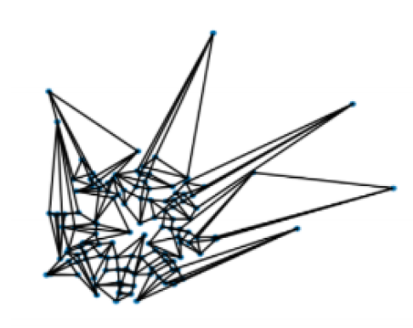
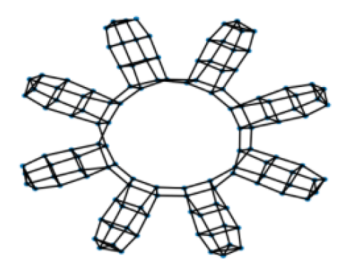
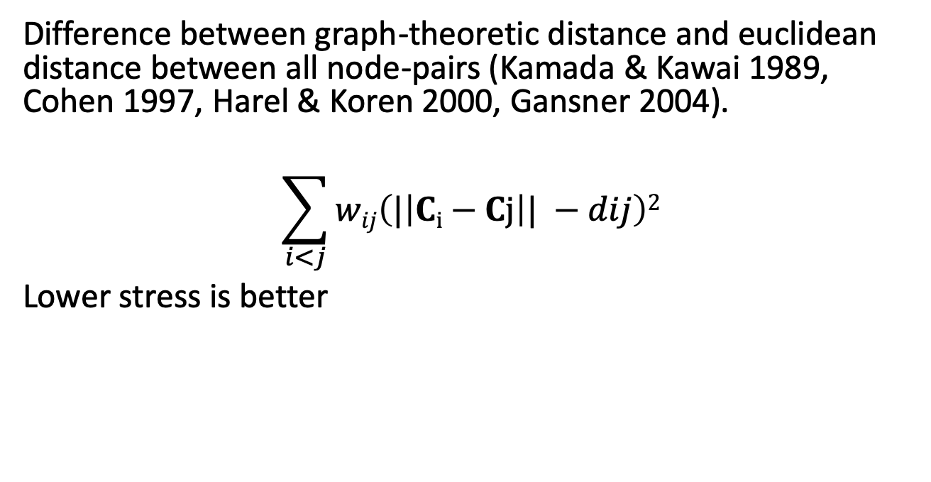
Stress
Difference between graph-theoretic distance and euclidean distance between all node-pairs (Kamada & Kawai 1989, Cohen 1997, Harel & Koren 2000, Gansner 2004).
$$\sum_{i<j}{wij\left(|\left|Ci−Cj\right|| −dij\right)2}$$
Lower stress is better
High stress
Low stress

Slide 6
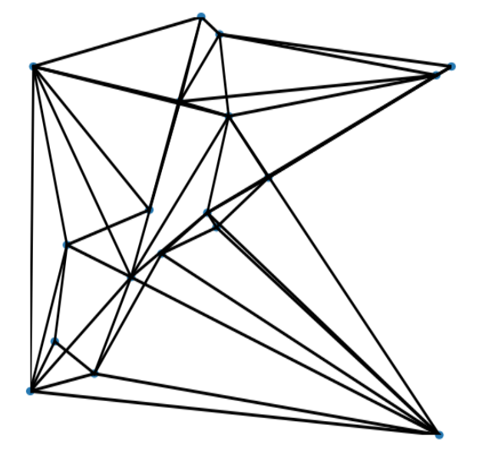
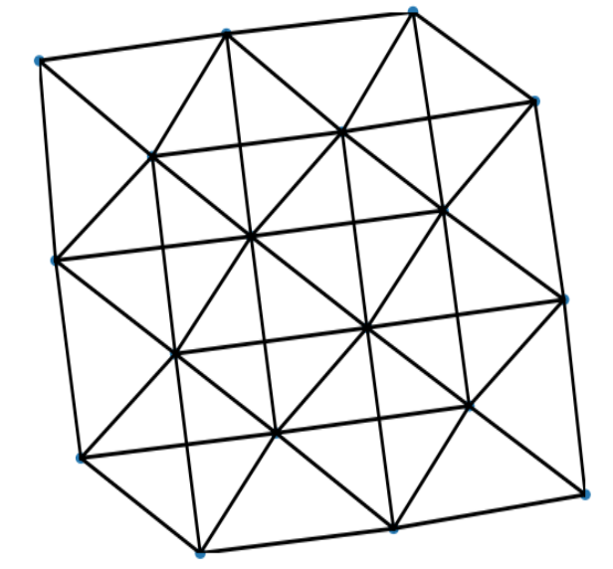
Edge Crossings
Number of crossing edge pairs in a graph
Lower crossings is better (Purchase et al. 1997)
High edge crossings
Low edge crossings

Slide 7
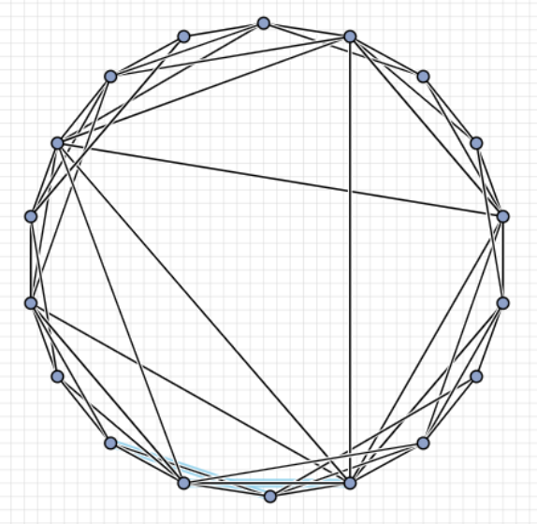
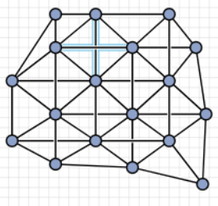
Crossing Angle
Smallest angle between all crossing edge pairs in the graph
Higher value is better (Argyriou et al. 2011, Huang et al. 2013, 2014)
Low crossing angle
High crossing angle
http://mozart.diei.unipg.it/gdcontest/contest2018/results.html

Slide 8
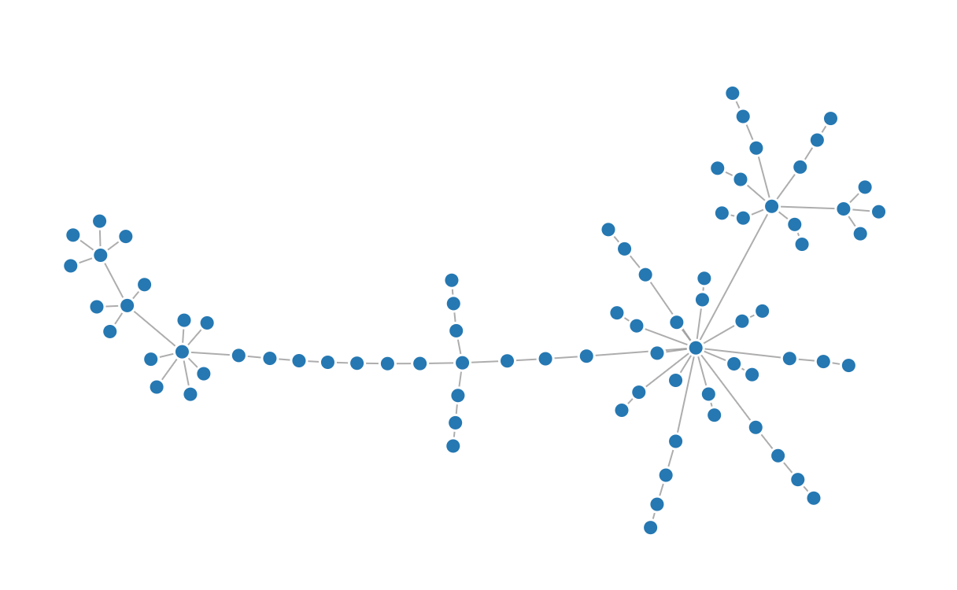
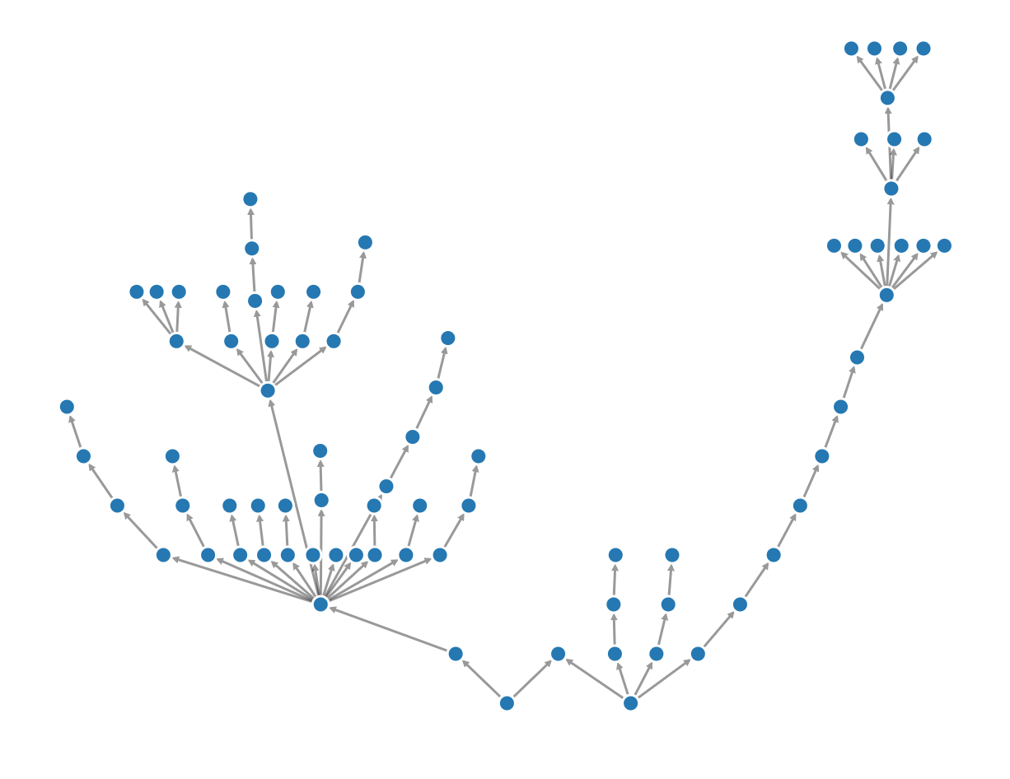
Upward Drawing
All edges in a directed acyclic graph (DAG) are pointing upward.
Non upward drawing
Upward drawing
https://ialab.it.monash.edu/webcola/examples/downwardedges.html

Slide 9
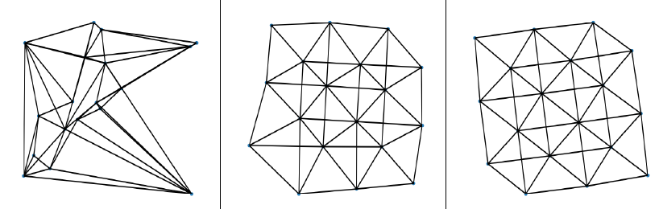
SPX: Balancing across readability criteria
Tübingen
KIT
SPX
Different layouts of a graph from gd 2018 contest on crossing angle maximization (automatic)
All graphs have near optimal crossing angle but SPX shows the graph structure best.
Notes:
Tubingen won in 2018
KIT won in 2017

Slide 10





Edge Crossing Minimization
Penalty for a crossing edge pair(A,B) (Shabbeer et al. 2010) is:
where
A = $\left[\begin{matrix}a_{1}^{x} & a_{1}^{y} \\ a_{2}^{x} & a_{2}^{y}\end{matrix}\right]$
,
B $=\left[\begin{matrix}b_{1}^{x} & b_{1}^{y} \\ b_{2}^{x} & b_{2}^{y}\end{matrix}\right]$
and
$$a2∙u=γ$$
b$2∙u=γ−1$
Notes:
Two nodes of A are (ax1; ay1), and (ax2; ay2) and similarly for B

Slide 11
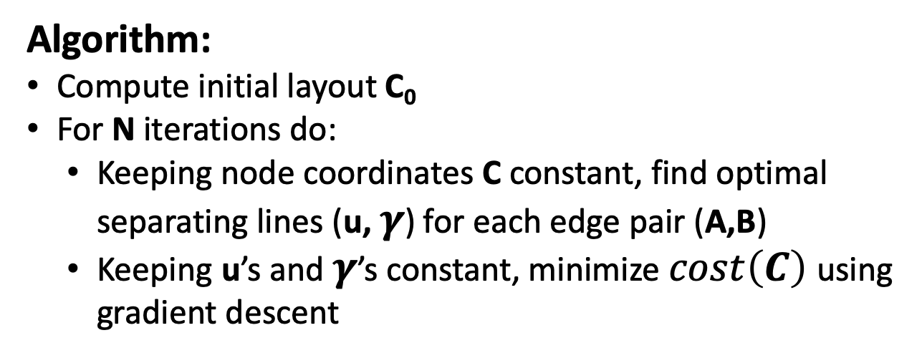
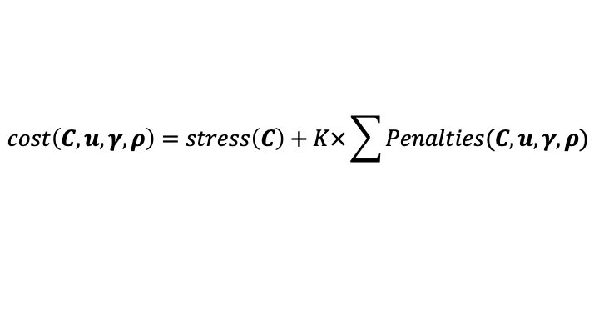
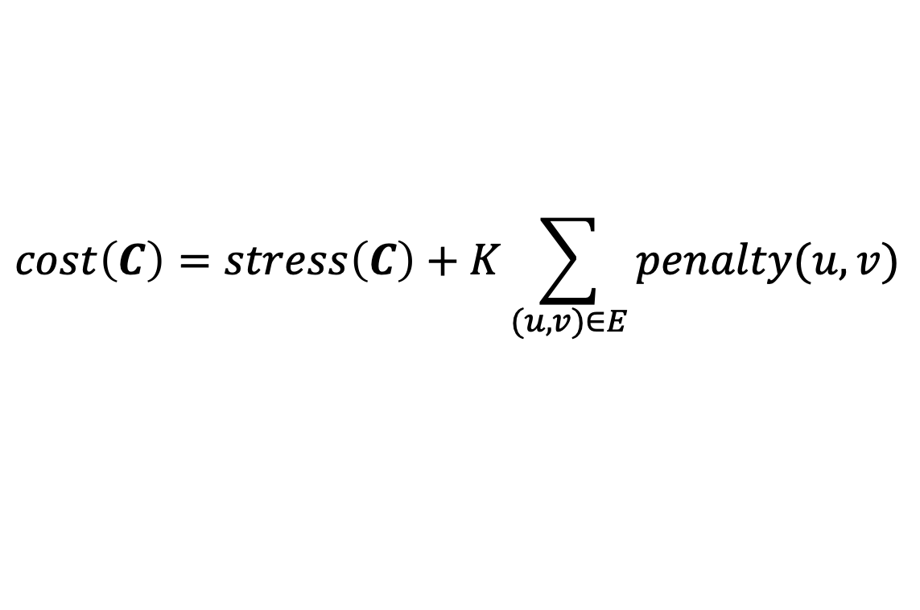
Stress plus edge crossing minimization
$$cost\left(C\right)=stress\left(C\right)+K\sum_{(u,v)∈E}{penalty(u,v)}$$
Algorithm:
Compute initial layout C₀
For N iterations do:
  Keeping node coordinates C constant, find optimal separating lines (u, $γ$) for each edge pair (A,B)
  Keeping u’s and $γ$’s constant, minimize $cost\left(C\right)$using gradient descent
$$cost\left(C,u,γ,ρ\right)=stress\left(C\right)+K×\sum{Penalties(C,u,γ,ρ)}$$

Slide 12
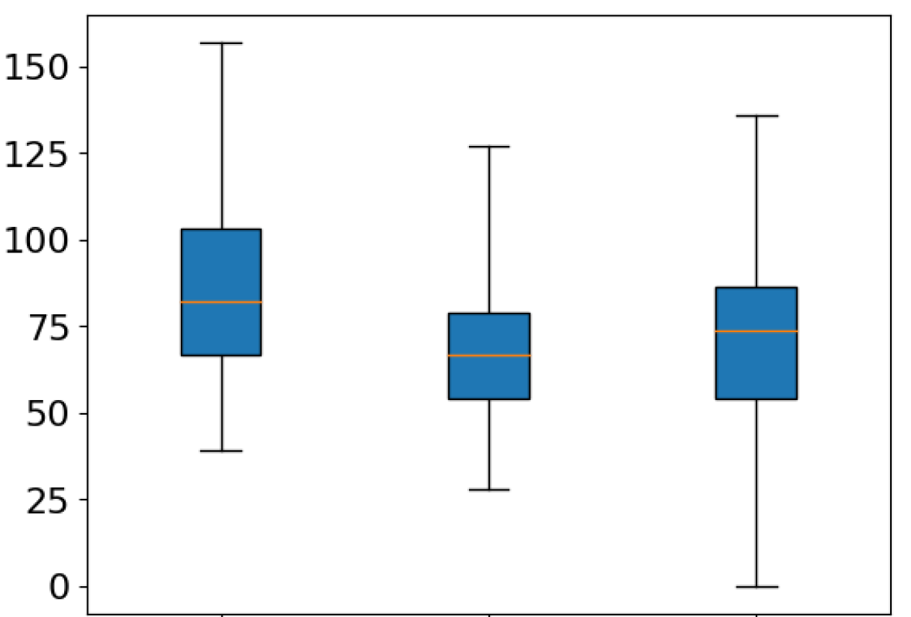
SPX achieves better results than Shabbeer et al. by introducing:
Binary penalties for edge pairs
Hyperparameter K to balance between stress and crossing penalties
Num crossings
Stress
Maj
SPX
Shabbeer
Comparison between stress optimization, SPX and Shabbeer algorithm on 100 community graphs (Radermacher et al. 2018)
Notes:
Shabbeer et al. use a compounding weight where each edge crossing gets
penalized more the longer it persists through the optimization iterations. We
found that such a penalty can result in the introduction of new edge crossings
for graphs that are larger and denser. With this in mind, we use a binary weight
for i: the value is 1 when edges intersect and 0 otherwise.
The cost function for stress plus crossing minimization further differs from
Shabbeer et al. in the criteria weighting parameter K.
TODO: Create a pairwise comparison plot for stress vs num crossings for this data

Slide 13
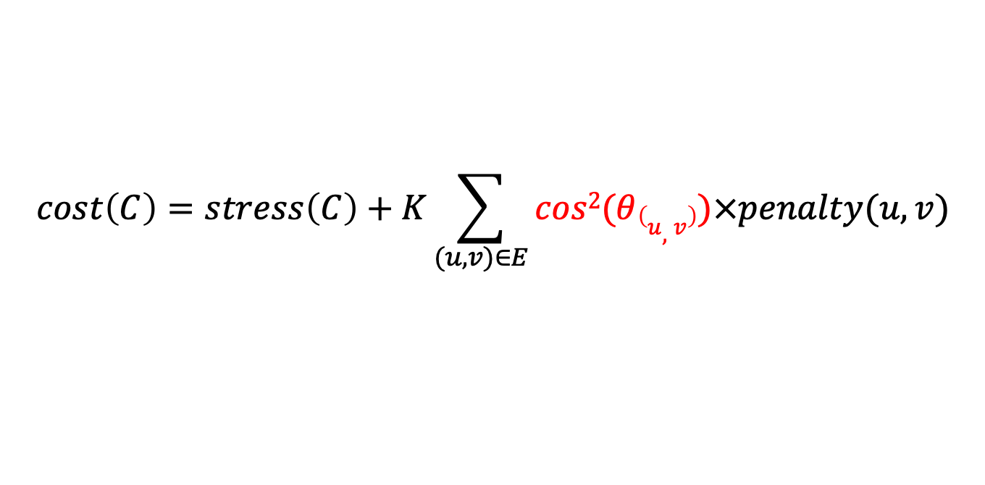
Crossing angle maximization
$$cost\left(C\right)=stress\left(C\right)+K\sum_{(u,v)∈E}{cos2(θ\left(u,v\right))×penalty(u,v)}$$
penalty for edge pair
Notes:
We introduce a factor of cos^2(theta) to heavily weight smaller angles and to constrain to positive values
Explicitly maximizes crossing angle and implicitly minimizes edge crossings

Slide 14


Upward Drawing
Add constraints of the form $y_{v}>y_{u}$for each directed edge (u,v)
v
$$y_{v}>y_{u}$$
u

Slide 15
Comparison across readability metrics
Dataset:
25 community graphs randomly selected
(100 nodes, 120-150 edges) (Radermacher et al. 2018)
Metrics:
Stress (ST)
Number of edge crossings (NC)
Crossing angle (CA)
Drawing area (DA)
Neighborhood preservation (NP)
Algorithms:
KIT (Demel et al. 2018)
Tübingen (Bekos et al. 2018)
SPX
Notes:
Community graphs are similar in nature. Hence we can perform comparisons across a group of them.

Slide 16
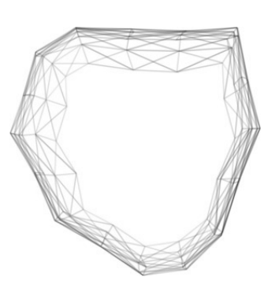
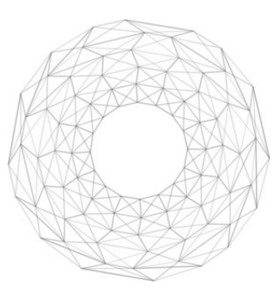
Neighborhood Preservation
Measures how the local neighborhood of the graph is preserved in the graph drawing (Kruiger et al. 2017)
Higher value is better.
Low neighborhood
preservation
High neighborhood
preservation

Slide 17
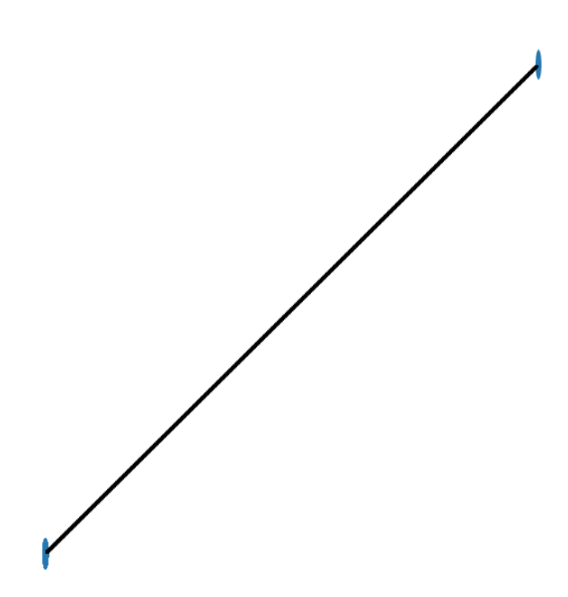
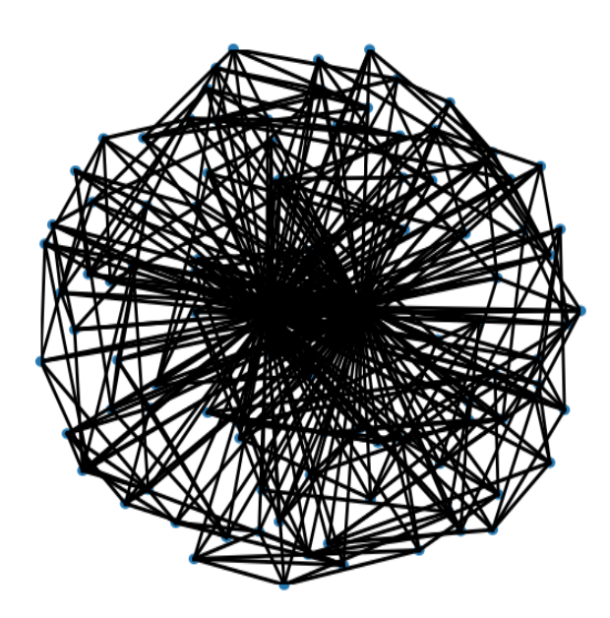
Drawing Area
Area occupied by the graph drawing
Lower value is better
High drawing area
Low drawing area

Slide 18
Experimental Details*
3 types of initial layouts
  Stress majorization (neato) [1]
  Force-directed layout (sfdp) [1]
  Random initialization
6 variants of gradient descent algorithm
  Vanilla, Momentum, Adam, Nesterov momentum, AdaGrad, RMSProp
10 values of K in the range [2⁻⁵ to 2⁵]
* SPX available at https://github.com/devkotasabin/SPX-graph-layout
[1] Available in GraphViz package

Slide 19
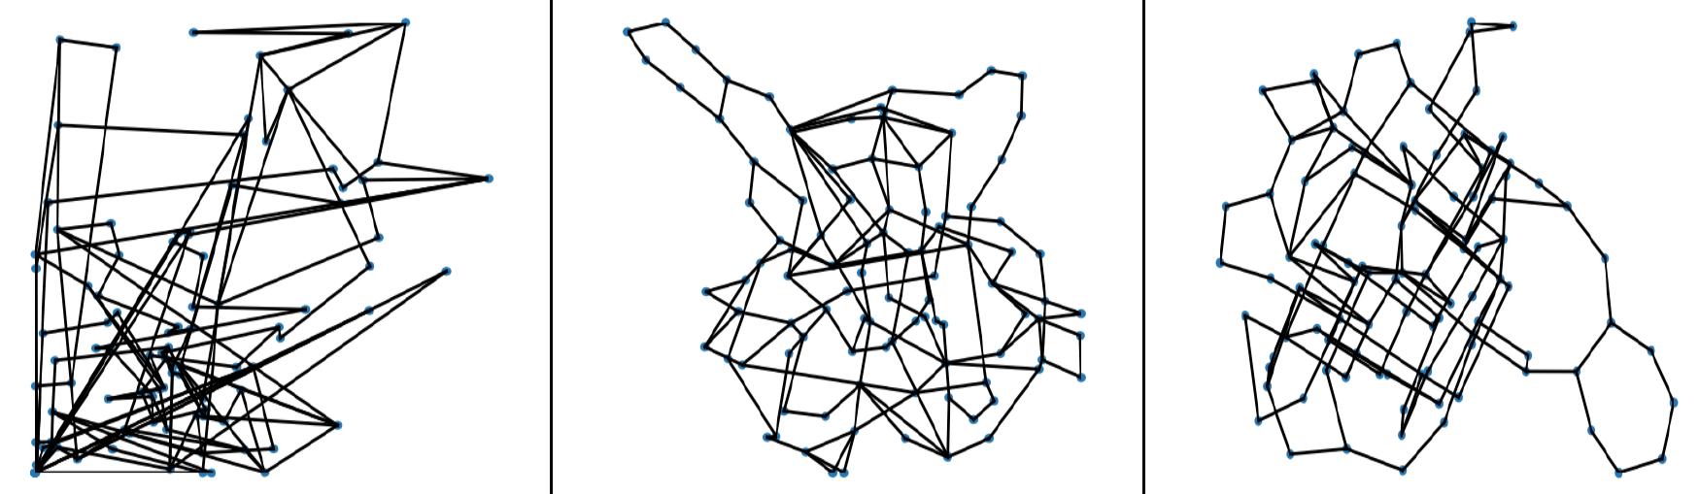
Outputs of 3 algorithms on a community graph
Tübingen
KIT
SPX
 | Tübingen | KIT | SPX
Crossing angle | 33.15 | 69.44 | 79.32
Stress | 2003.44 | 660.7 | 615.04
Neighborhood Preservation | 0.15 | 0.35 | 0.3
Notes:
SPX achieves best crossing angle and stress value. Performs very close to KIT (winner) in terms of number of crossings and neighborhood preservation.

Slide 20
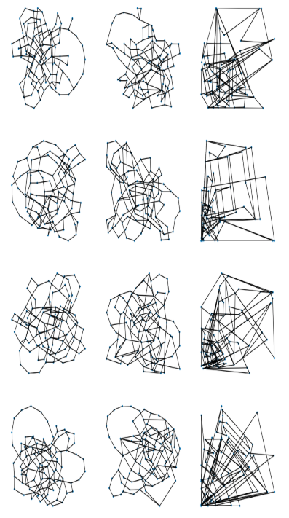
More drawings of community graphs
Tübingen
KIT
SPX

Slide 21
bad
Algorithms
num
crossings
good
good
bad
log (stress)
Pairwise comparison between stress and edge crossings for 3 algorithms on 25 community graphs

Slide 22
90 – crossing
angle
num
crossings
1 - NP
log(stress)
log(drawing
area)
log(drawing
area)
Algorithms
90 – crossing
angle
90 – crossing
angle
1 - neighborhood
Preservation (NP)
1 - NP
Pairwise comparison across readability criteria
num
crossings
num
crossings
Lower left corner is better
log(stress)
Notes:
Points in the lower left corner indicate good performance in the two metrics.
Plots show that most of the SPX drawings are in/close to the well-performing corner

Slide 23
SPX Runtime
Runtime for 25 community graphs
(100 nodes, 120-150 edges)
 | Per parameter (s) | Total time (mins)
Min | 3.89 | 5.84
Avg | 6.48 | 9.72
Max | 11.72 | 17.58
Notes:
11th graph of 2018 GD contest (709 nodes and 1602 edges) - SPX takes around two hours
Max runtime of KIT – less than a minute
Runtime of Tubingen algorithm – run for 10 minutes and take the best drawing

Slide 24
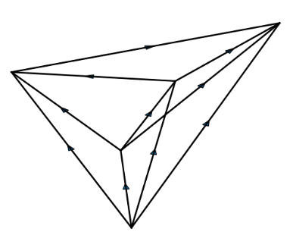
Comparison of Upward Drawings
Dataset: 4 trees and 30 DAGs
Algorithms:
Dot
Dagre
OGDF with barycenter heuristic (ogdfb)
OGDF with median heuristic (ogdfm)
SPX
Readability Criteria:
Stress (ST)
Drawing Area (A)
Number of crossings (CR)
Notes:
We do not compare with cola because it does not minimize edge crossings explicitly.

Slide 25
Comparison of Upward Drawings
 | Dagre | Dot | Ogdfb | Ogdfm | SPX
Stress | 0 | 0 | 0 | 0 | 30
Area | 0 | 0 | 0 | 0 | 30
Num crossings | 2 | 5 | 8 | 11 | 14
Number of wins for 30 randomly generated dags. Ties are attributed to all winning algorithms.
Notes:
SPX wins on all 4 binary trees (All algorithms produce planar drawings and hence win on crossings.) SPX wins most times on the number of crossings on 30 DAGs and wins on other metrics stress and area.
Other algorithms work on integer coordinates while SPX works on real coordinates. If we constrain the resolution of a SPX drawing, then SPX produces huge drawing areas.

Slide 26
Conclusion
Optimizing single criteria can result in unreadable drawings.
Balancing multiple layout criteria is important.
SPX optimizes multiple layout criteria simultaneously.
SPX achieves drawing quality close to single criterion state-of-the-art algorithms.
Notes:
SPX consistently produces good drawings across all the metrics.

Slide 27
Future work
Incorporate additional layout criteria (X)
Speed up SPX
Good Initial configurations
Good values for hyperparameters
Notes:
SPX relies on a combination of linear program and gradient descent. It is prohibitively slow for large graphs.
Investigate ways to speedup such as multi-level layout

Slide 28

Thank you
Special thanks to
Demel et al. and Bekos et al. for providing their crossing angle maximization code to compare with SPX.
Michelle Strout, University of Arizona for providing computing resources.
Carlos Scheidegger and Josh Levine, University of Arizona for their valuable feedback.
Supported in part by NSF grants:
CCF-1740858, CCF-1712119, DMS-1839274, DMS-1839307, III-1656958, 1844573
SPX available at
https://github.com/devkotasabin/SPX-graph-layout
https://devkotasabin.github.io/
Notes:
With this I have reached the end of my presentation. SPX is open source and can be found on the link above.
I would like to thank Demel et al. and Bekos et al. from KIT and Tubingen for providing their code to compare against.And I would like to researchers from Univ of Arizona for providing us computing resources and valuable feedback. And I would like to thank the National Science Foundation for funding our research.
Thank you and I am open to questions.

Slide 29
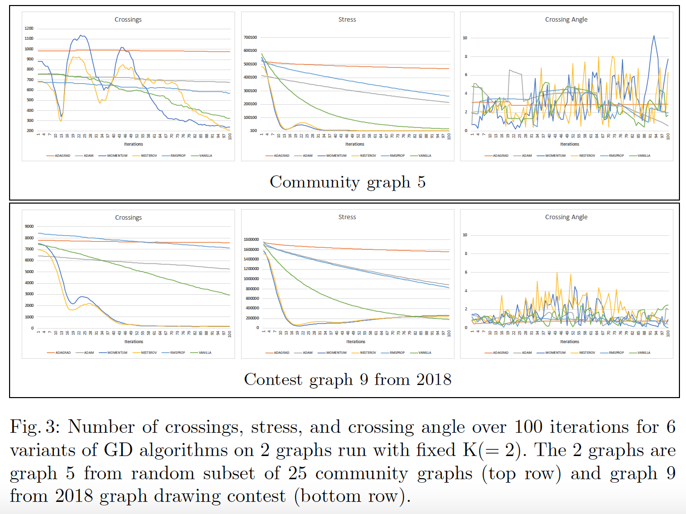
Appendix: Convergence Results

Slide 30
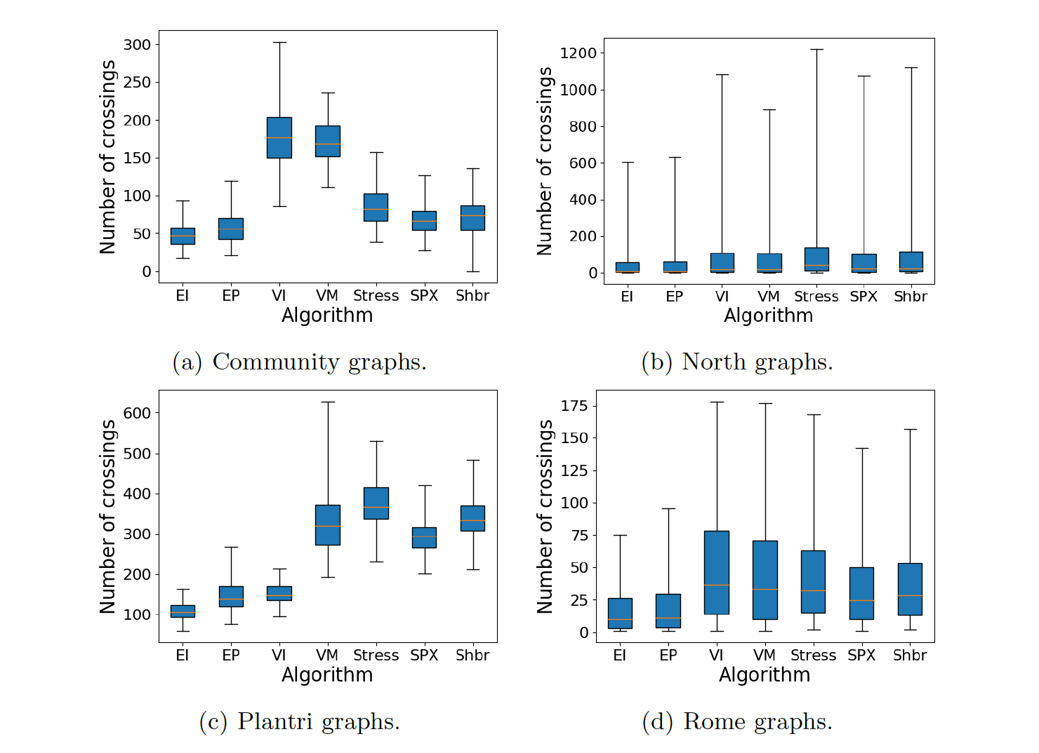
Appendix: Edge crossing minimization

Slide 31
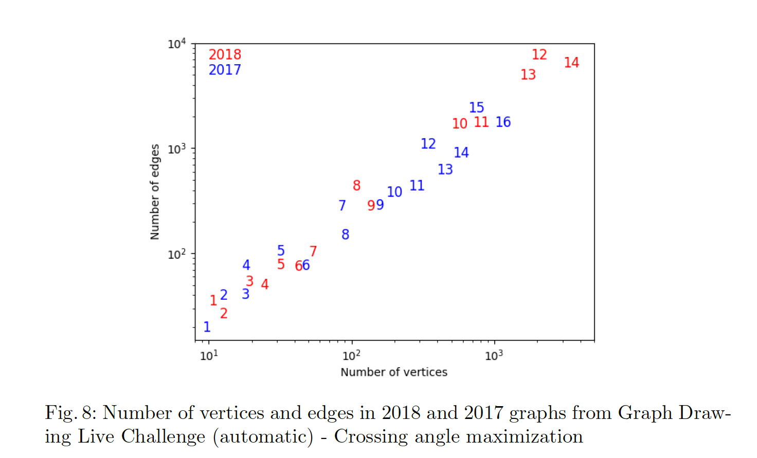
Appendix: GD 2018,2017 crossing angle maximization challenge graphs

Slide 32
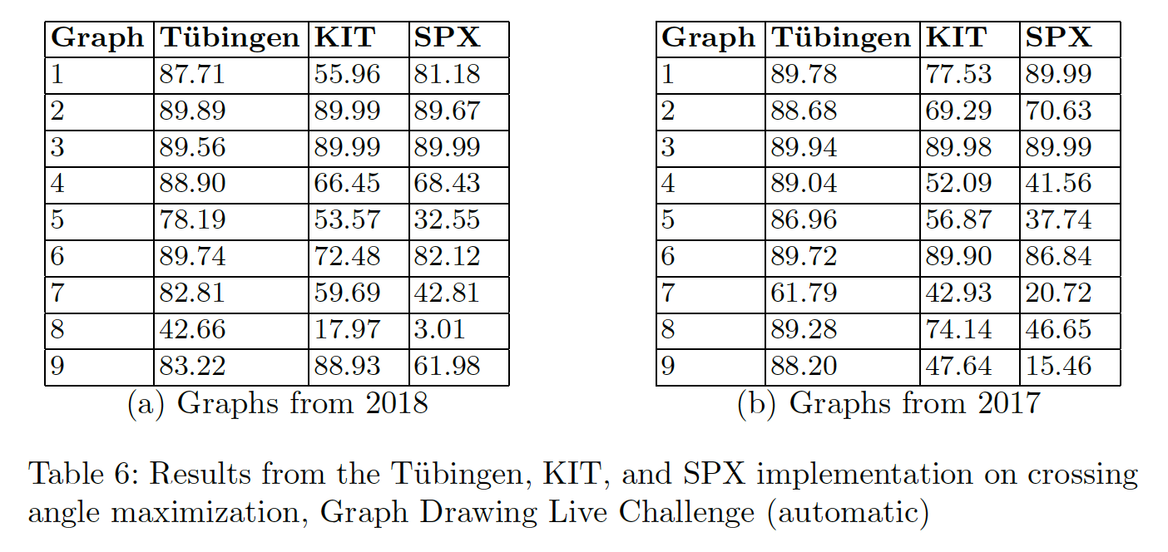
Appendix: GD challenge results

Slide 33
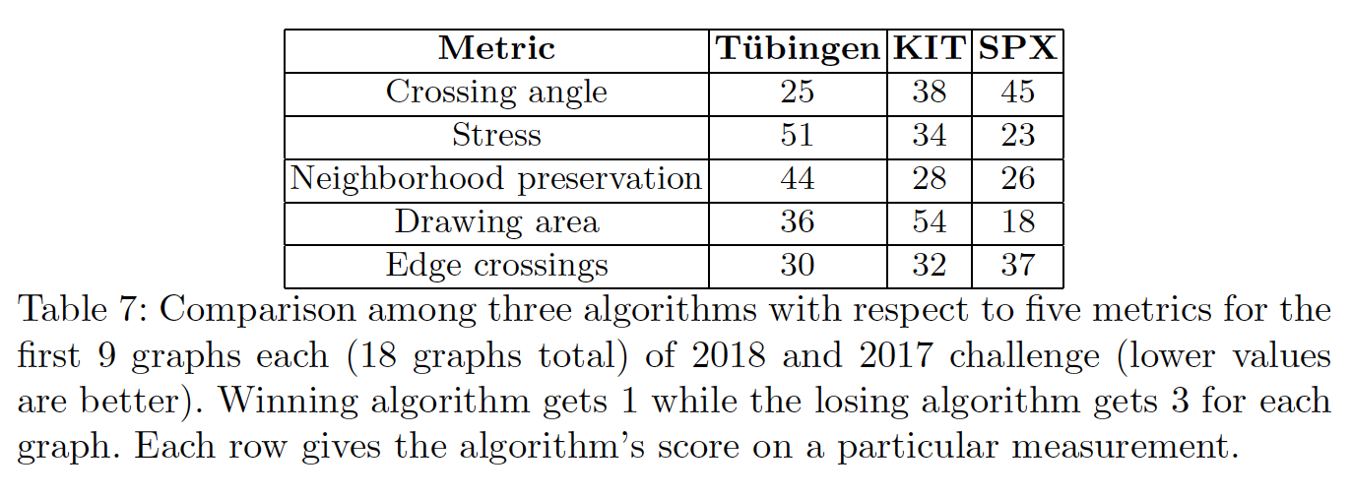
Appendix: GD challenge results

Slide 34
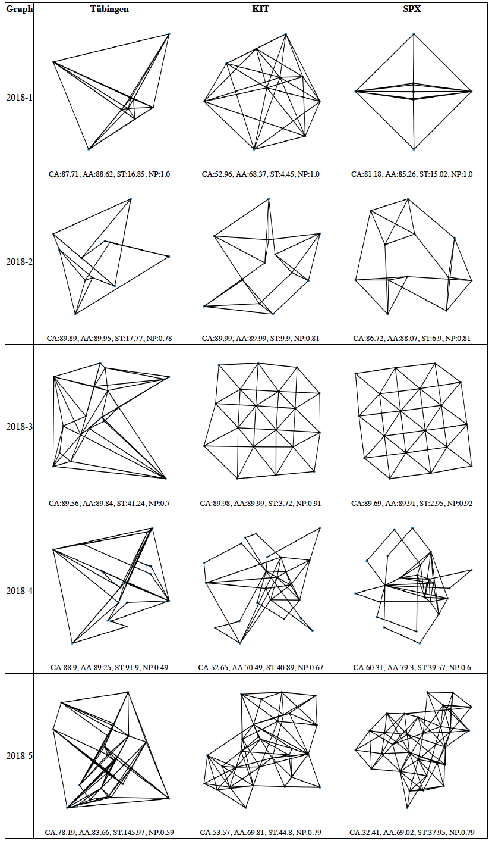
Appendix: GD challenge outputs on 2018 graphs

Slide 35
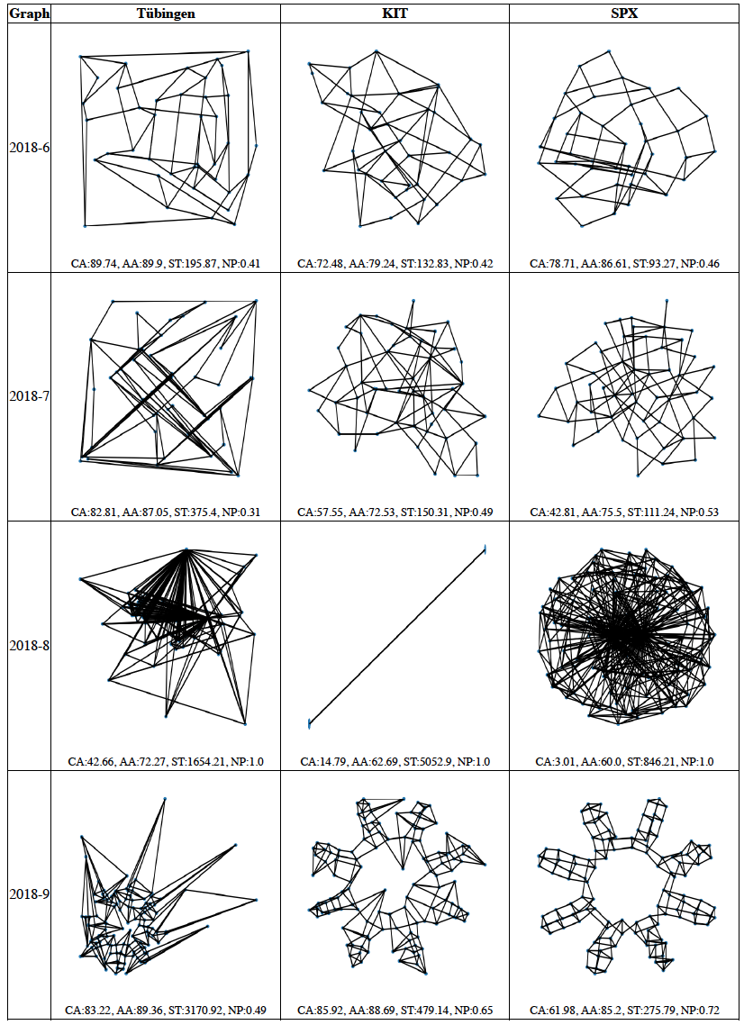
Appendix: GD challenge outputs on 2018 graphs

Slide 36
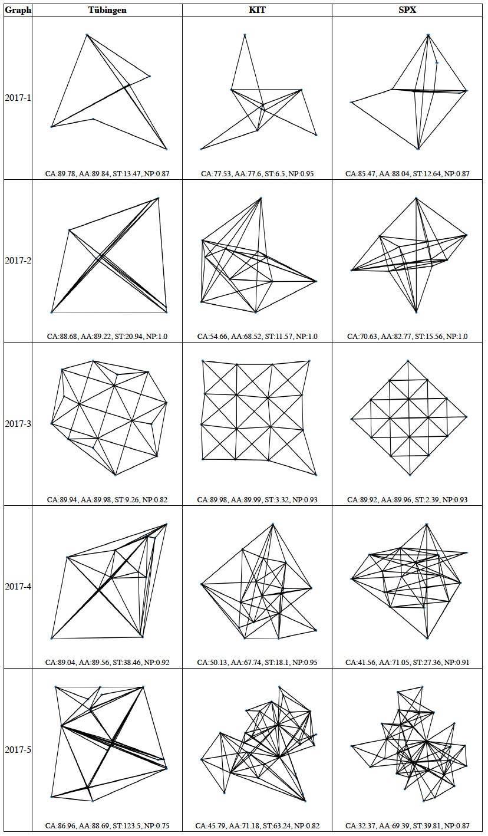
Appendix: GD challenge outputs on 2017 graphs

Slide 37
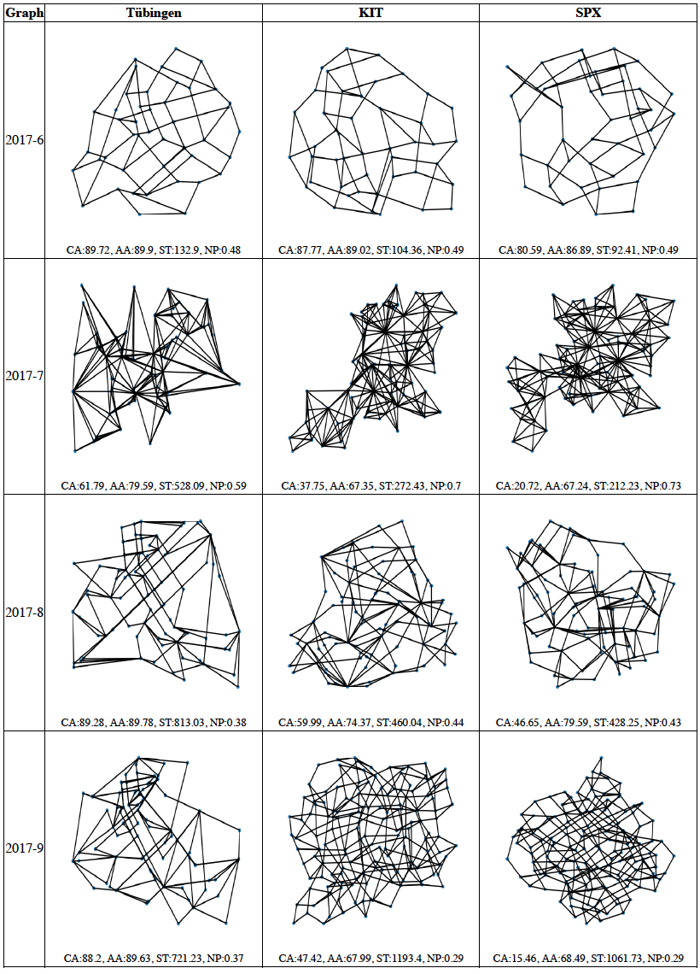
Appendix: GD challenge outputs on 2017 graphs

Slide 38
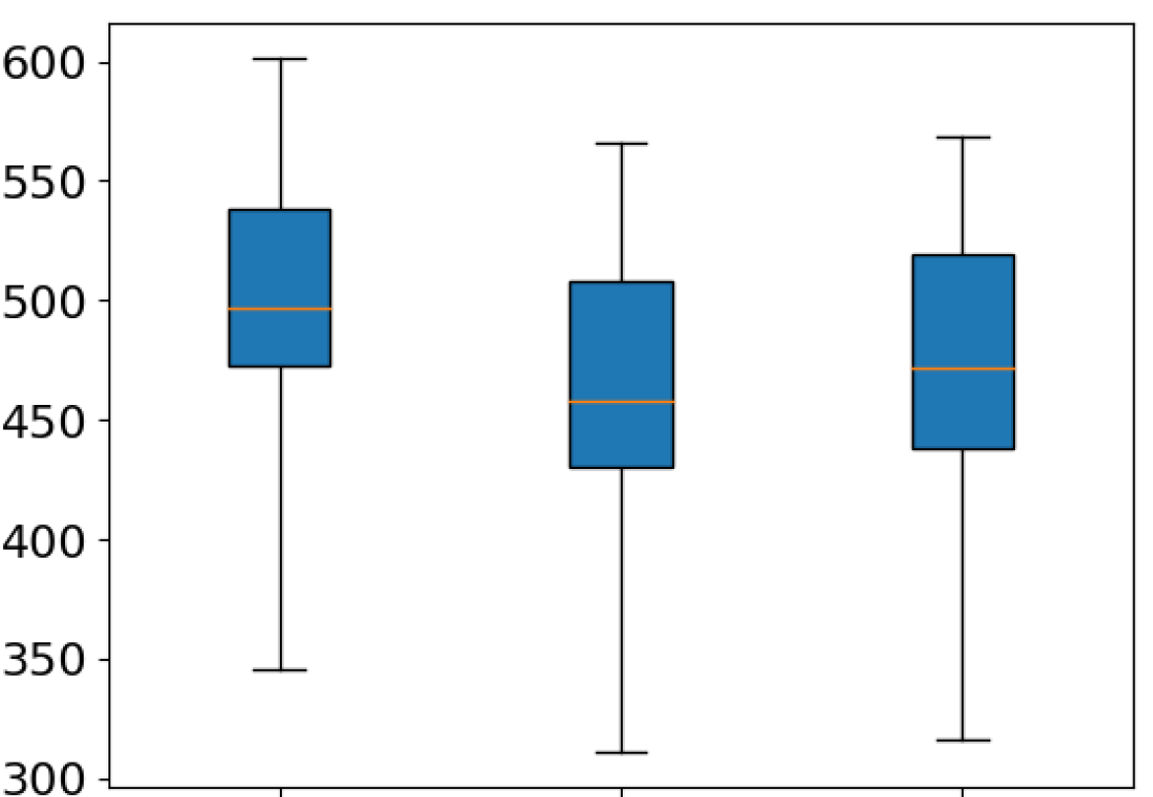
Appendix: Stress Maj vs SPX and Shabbeer on stress
Stress
Stress
Min
SPX
Shabbeer

Slide 39
Appendix: Selected Community graphs

Slide 40
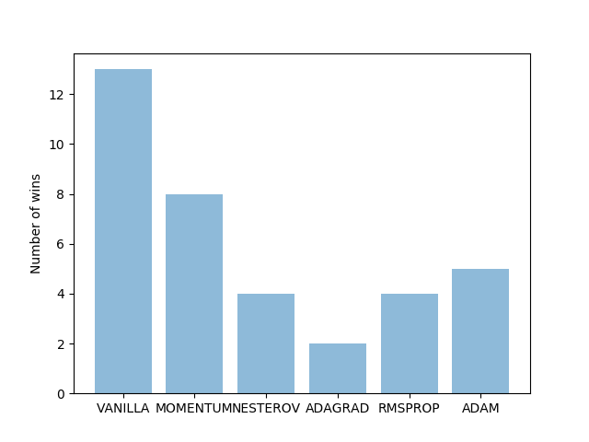
Appendix: Winning GD algorithms

Slide 41
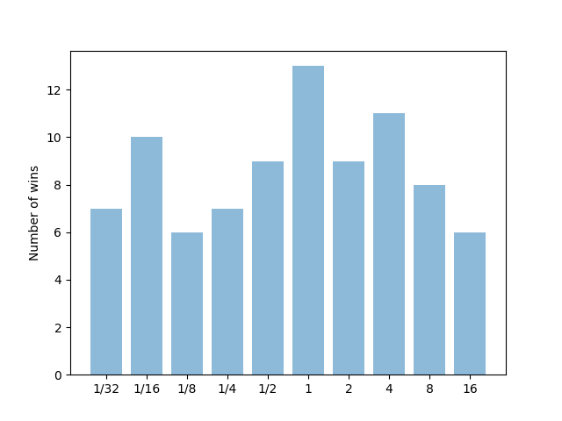
Appendix: Winning hyperparameter K

